Slide 1
AEI Housing Market Indicators (HMI)
Transforming data into information, information into knowledge, knowledge into action.
Edward Pinto (pintoedward1@gmail.com) and
Tobias Peter (Tobias.Peter@AEI.org)
AEI Housing Center
AEI.org/housing
May 3, 2022
Link to AEI HMIs:
https://www.aei.org/housing/housing-market-indicators/
We grant permission to reuse this presentation, as long as you cite as the source:
AEI Housing Center, www.aei.org/housing.

Slide 2
AEI Housing Market Indicators: An Introduction
Provide accurate and timely metrics for the housing market. These include:
    Mortgage Risk/Leverage
      Particular attention is paid to agency first-time buyer volume and risk
    House price appreciation trends
    Housing sales
      New and existing sales whether institutionally financed, cash, or other-financed
    Months’ inventory
The housing market is influenced by many different levers. Measuring and evaluating with the right metrics provides a clearer understanding of market trends.
  AEI HMI adds geography and price points to the broad set of metrics:
    Geography: national, state, and selected metros
      House prices down to the census tract level
    Price points: low, low-medium, medium-high, and high price tiers
      Price tiers are defined based on the availability of leverage for borrowers at the metro level.
Expanded Housing Market Indicators use and connect many different datasets:
    HMDA
    Public Records Data
    National Mortgage Risk Index (agency MBS data)
    CoreLogic’s LLMA and Black Knight’s McDash (servicer data)
    Fannie Mae’s Loan Performance data and Freddie Mac’s Loan-Level Data (acquisition data)
    FHA Snapshot data (endorsement data)
    Data from Zillow on existing home sales and unique listings
Advantages of the AEI Housing Market Indicators:
  Most in-depth resource for key housing data and trends (select data available online for download)
  Accurate, timely, and in-depth coverage of purchase trends
  Connects the dots for many housing indicators, yielding the most comprehensive analysis of the housing market and boom/bust cycles
Detailed methodologies are available after “Remaining Briefing Dates” slide.

Slide 3
Market Shares by Guarantor Type and Price Tier:
2020 Purchase Loans
To better track house price trends, we divide the market into 4 leverage-based price tiers. In the low and low-medium price tiers, FHA accounts for over a quarter share in each, while together FHA and the GSEs have a combined share of around 80%. The battle for market share between FHA and the GSEs is therefore largely taking place in these price tiers. An unfortunate consequence of this taxpayer backed battle is upward pressure on constant-quality house price appreciation.
2020 | Price Tier
 | Entry-level |  | Move-up
 | Low | Low-Med | Med-High | High
Mortgage Default Rate | 15.3% | 14.2% | 9.5% | 4.1%
Market Share* | 23% | 29% | 42% | 6%
*Market share of all institutionally financed home sales in 2020 by tier.
Note: Data excludes Rural Housing Service. In 2017, Rural Housing Service loans made up 3% of the low tier, 2% of the low-medium tier, and a negligible amount of the two upper tiers. Price tiers are set at the metro level and are defined as follows: Low: all sales at or below the 40th percentile of FHA sales prices; Low-Medium: all sales at or below the 80th percentile of FHA sales prices; Medium-High: all sales at or below the 125% of the GSE loan limit; and High: all other sales.
Source: HMDA, Public Records and AEI Housing Center, www.AEI.org/housing.

Slide 4
What are the AEI Housing Market Indicators?
Indicator | Key Metric(s) | Additional Features | Geography | Frequency | Tier/ Segment* | Purpose
Home Prices & Supply | HPA, Months' Supply | Interactive maps & price tier cutoffs | National, largest 50 metros | Monthly | Overall & 4 tiers | Real-time data on HPA & months’ supply for 50 metros.
National & Metro Housing Market Indicators | HPA, Months’ Supply, Mortgage Risk Index, Average Sale Price, NC Share of Sales | Reports for each metro & interactive maps | National, largest 60 metros | Quarterly | Overall & entry-level & move-up | A more comprehensive analysis of the housing market in 60 metros (but slightly less recent & only for 2 market segments).
Mortgage Default Rate | Mortgage Default Rate | Time series data on credit scores, CLTVs, DTIs, & other key metrics | National | Monthly | Overall, first-time & repeat buyers | Comprehensive resource for mortgage origination & risk data for agency loans.
The State of the Housing Market | County & State data: HPA, Months’ Supply, NC, Mortgage Risk Index, Entry-Level Price-to-Income Ratio | Housing market metrics (supply, NC, leverage, etc.) & how they affect entry-level affordability | State & county, some metro indicators | Annual | Varies by indicator | A multitude of housing market indicators at the county & state level. These data are aggregated to derive trends on the state of the housing market.
The Carpenter Index | Share of Entry-level Sales Affordable to the Average Carpenter Household | Metro rankings, affordability heat map, change in affordability, & other affordability metrics | Largest 100 metros | Annual | Entry-level | “They can build it, but can they afford it?” The study ranks housing affordability in the entry- level market for 100 metros for blue-collar workers.
The Tech Worker Index | Share of Home Sales Affordable to the Average Tech Worker Household | Metro rankings, geographic trends, and the impact of work from home (WFH). | Largest 100 metros | Annual | Overall | The index investigates both affordability trends and why the WFH phenomenon is destined to have a large and continuing impact in the years ahead.
Tier/Segment = Price Tier/Market Segment; HPA = Home Price Appreciation; NC = New Construction
https://www.aei.org/housing/housing-market-indicators/

Slide 5
What are the AEI Housing Market Indicators? (cont.)
Indicator | Key Metric(s) | Additional Features | Geography | Frequency | Tier/ Segment | Purpose
Best & Worst Metros to Be a FTB | Price-to-Income Ratio for over 3 million FTB Purchases | FTB stats on home prices, income, price/sq. ft., & sq. ft. of living area | Largest 50 metros | Annual | First-time buyers | This study ranks 50 metros based on their affordability for first-time homebuyers.
New Construction | NC Share of Sales | Interactive maps/charts and proposed policy solutions. | National, State, County, ZIP, Census Tract | Quarterly | Overall & 3 tiers (combines med-high & high) | Near real-time NC data at the census tract level & above.
Land Price and Land Share | Change in Land Share and Land Prices | Interactive maps on land prices, land shares, & changes over time in these indicators | ZIP (also census tract, county, metro, state, & nation) | Annual | None | The change in land share has been found to be highly predictive of house price boom/bust cycles.
Market Trends Report | HPA*, Mortgage Default Rate, Home Sales, Months’ Supply, NC Share | Current and historical market trends affecting the market price and intrinsic value of the subject property and its neighborhood | 107+ million U.S. property addresses | Updated as data become available | Overall & 4 tiers | Provides trends affecting the market price & intrinsic value of the subject property, the subject’s neighborhood, & its broader market areas.
Collateral Risk | Relationship btw. land shares, mortgage default risk, HPA*, and borrower income or minority status | An explanation for housing boom & bust cycles by tracking collateral risk before & after the Great Recession and during the current cycle. | majority of ZIP Codes/Census Tracts | Annually | None | Identify areas most at-risk from an economic downturn
Housing Arbitrage Index | Price Ratio (Median for New to Old Home) | Home sq. ft. ratio, price/sq. ft. ratio, change in walk score and year built. | CSA/CBSA | Quarterly | None | Measure how much money an individual could save by selling a home in their current location and moving to another.
HPA = Home Price Appreciation; NC = New Construction; FTB = First-time Buyer; Tier/Segment = Price Tier/Market Segment
https://www.aei.org/housing/housing-market-indicators/

Slide 6
Indicators and Data
National Mortgage Default Rate (NMDR) – based on 58.5m purchase & refi loans
  MDR is a stress test, similar to a car crash safety rating or hurricane rating for buildings.
  MDR assesses default risk based on the performance of the 2007 vintage loans with similar characteristics.
  Goal: Monitor market stability through accurate, real-time tracking of leverage.
  Series begins in September 2012.
  Data are for government guaranteed loans.
Historical NMDR – based on 92m purchase loans
  Covers a quarter century of mortgage risk.
Home sales – based on 47.6m home sales
  Data measure home sales for entire nation and include property and borrower level data.
  Series begins in January 2012.
Supply/Demand – based on over 2,200 counties
  Data measure months’ supply at metro and county level.
New Construction Sales – based on 5.1m new construction sales
  Data identify newly constructed home sales.
  Series begins in January 2012.
House Price Appreciation – based on 28m sales of existing homes
  Using a “quasi” repeat sales index (see appendix).
  Series begins in January 2012.
Rate Lock Volume – based on 20.9m rate locks
  Using Optimal Blue, a rate lock software provider with roughly a third market coverage.
  Data are updated daily, begin in 2013, and are limited to lenders who have used Optimal Blue since Dec-18 or earlier.

Slide 7
HMI Key Takeaways
Purchase volume to remain robust at least until May 2022 despite headwinds from higher interest rates and rapid HPA.
  January 2022 agency purchase volume was down 10% compared to 2021, but up 19% from 2020.
  Based on Optimal Blue data, purchase volume in 2022 week 17 is down 1% and up 9% over 2021 and 2019, respectively.
Increases in credit and debit card spending are fueling aggregate demand and help explain why we are now experiencing a strong bout of inflation.
  In weeks 1-9 of 2022, inflation-adjusted spending for income quintiles 4 and 5 was up 14% and 18% (y-o-y), respectively, vs. 8% (y-o-y) for quintile 1.
The current housing boom may have staying power.
  Total housing inventory is at historically low levels and the supply-demand imbalance is driving prices up.
  Mortgage risk is much lower today than during the 2000s with the exception of FHA.
  Home prices may seem exuberant, but the inflation in the consumer prices account for about half the growth.
  Home price increases are now in line with rent increases, another difference from the early 2000s.
  Finally, higher income workers, who have greater opportunities to work from home, are now able to profit from arbitrage opportunities offered by vastly different home prices across metros and regions.
Rampant Home Price Appreciation (HPA) continues to rise with the national rate of HPA for March 2022 coming in at 16.6% (preliminary), up from 12.0% in March 2021.
  While home prices are booming everywhere, metros in Florida and metros effected by California out-migration are seeing prices rise the most.
  This rapid pace of HPA is driven by supply constraints, relatively low rates, and an arbitrage opportunity enhanced by the work from home economy.
  Active listings set a series’ low for the month of March, down 19% from the already depleted levels of 2021 and at about 1/3 of levels in 2017-2020.
  Without more inventory or a mortgage rate upwards of 6%, HPA is expected to remain in the mid-teens for the remainder of 2022.

Slide 8
Agency Purchase Counts
  Agency purchase loan volume continues to run high. January 2022 volume was down 10% from the same month in 2021, but up 19% from 2020. Based on Optimal Blue data, we expect volume to continue to run well above 2019 at least until May 2022.
Source: AEI Housing Center, www.AEI.org/housing.

Slide 9
Purchase Activity Outlook Given Headwinds
Purchase volume in 2022 week 17 is down 1% over 2021 and up 9% over 2019, notwithstanding interest rates being up 2 1/8% and 3/4% compared to the same week in 2021 and 2019, respectively. Year-to-date 2022 volume is down 8.0% over the same period in 2021. Yet HPA remains robust. This is evidence of an unhealthy market condition as a historically low supply combined with strong demand continues to fuel rapid HPA. The cure is for rates to increase further to 6% or 7% (currently at about 5.5%). Therefore, the Fed should immediately begin aggressive quantitative tightening to further raise mortgage rates and slow HPA. Note that week 17 refers to Apr 23 – Apr 29, 2022.
Note: Rate locks are limited to lenders who joined Optimal Blue Dec. 2017 or earlier.
Source: Optimal Blue and AEI Housing Center, www.AEI.org/housing.

Slide 10

Cash-Out and No Cash-Out Refi Outlook
Cash-out (CO) volume in 2022 week 17 reflects increasing interest rates, down 30% over 2021 and approaching the low levels of 2019. While CO volume appears to have stabilized at this low level, high risk FHA CO now comprises 23% of CO volume, up from 10% at the beginning of 2022. No cash out volume is at its lowest level of the 2019-22 period due to rates having risen 2 1/2% since the beginning of 2021, fueling refi burnout. Volume in 2022 week 17 is down 90% compared to the same week in 2021. Note that week 17 refers to Apr 23 – Apr 29, 2022.
Note: Rate locks are limited to lenders who joined Optimal Blue Dec. 2017 or earlier.
Source: Optimal Blue and AEI Housing Center, www.AEI.org/housing.
10

Slide 11
Rate Lock Share by Loan Purpose
The purchase loan share of the entire origination market continues to grow, reaching 78% in 2022 week 17 and passing early 2019 levels. This is up from 32% in early 2021 and 51% in 2022 week 1. We expect this share will stabilize at this high level as refi volume declines have begun to level out. Volume in week 17 for all loan purposes was 54,800, a third of the series’ weekly high of 172,400 set in week 9 of 2020. With both no cash-out and cash-out refis now declining, this will be a test for lenders heavily dependent on refis. FHA share is up 13 ppts at 23% from 10% in 2022 week 1, indicating that higher risk borrowers are less deterred by rising rates. Note that week 17 refers to Apr 23 – Apr 29, 2022.
Note: Rate locks are limited to lenders who joined Optimal Blue Dec. 2017 or earlier.
Source: Optimal Blue and AEI Housing Center, www.AEI.org/housing.

Slide 12
Credit and Debit Card Spending, Aggregate Demand, and Inflation (Cont’d)
In weeks 1-14 of 2022, inflation-adjusted spending for income quintiles 4 and 5 was up 14% and 18% (y-o-y), respectively, vs. 8% (y-o-y) for quintile 1.* For lower income quintiles, non-necessity spending is being curtailed (not shown). Therefore, we expect quintiles 4 and 5 to be strong contributors to demand pull inflation in 2022 due to the continuing wealth effect. With y-o-y HPA expected to average 17% for December 2022 and still be at 10-12% for 2023, demand pull inflation will be fueled well into 2023.
* We assign each ZIP code to a quintile based on its ratio of income to area median income (AMI). The lowest quintile had a median income of 63% of AMI, while the highest quintile had a median of 136% of AMI.
Note: Total spending refers to national household credit and debit card spending. Total spending accounts for about 45% of all Personal Consumption Expenditures (PCE). All data are in nominal dollars.
Source: American Community Survey (ACS) 2019, HMDA, Commerce Signals, a Verisk Analytics business, and AEI Housing Center.

Slide 13
Purchase Loans with Total DTI Greater than 43%
  The sustained decline in the DTI > 43 share since March 2020 has ended. The share began to tick up again for all agencies except RHS around May 2021, even before mortgage rates started to climb. This indicates a reversal of the more prudent underwriting standards ushered in by the pandemic. Given the low supply, increasing DTIs will help fuel home price appreciation.
Note: Portfolio loans run through June 2021 to account for delayed securitization.
Source: AEI Housing Center, www.AEI.org/housing.

Slide 14
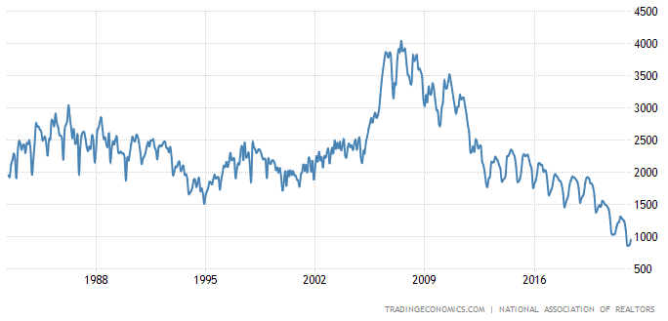
Total Housing Inventory is at Historical Low
The Dallas Fed recently warned that a new “Housing Bubble” was brewing. The key metric for the Fed’s research is the Price-to-Rent ratio, which may be sticky. However, as we will be noting, rents are now increasing rapidly. While there is no doubt we are in a housing boom, a bubble involves a psychological component that home prices are no longer driven by fundamentals and can only go up. Another of a number of key differences between today’s market and the pre-housing bubble years of 2005-06 is the incredibly low housing inventory– 950K today compared to 2.4-2.5 million in 2005-06– which suggests this boom has staying power. Due to the low supply levels, it will take even higher rates to slow demand and reach a supply/demand equilibrium.
US Total Housing Inventory*
* The NAR’s total housing inventory figures differ from the Realtor.com total active listings, shown on slide 25. The NAR counts the total inventory available over a particular month, while Realtor.com reflects what inventory looks like on a typical day in that month. However, the resulting trends are similar.
Source: Trading Economics and National Association of Realtors

Slide 15
Supply-Demand Imbalance in the Market Is Driving Prices Up
Months’ supply is far below the levels in 2005. According to the NAR, monthly inventory for Feb. 2022 was at 1.9 mos. compared to 4.1 mos. in Feb. 2005. Given the strong inverse relationship between the level of supply and price movements, there is too much demand chasing too little supply. This has led to a rapid increase in home price appreciation (HPA)--19.4% in Feb. 2022, triple the rate of 6.4% in Feb. 2020. In order for HPA to slow dramatically, months’ supply will need to return to equilibrium levels (6 months).
National Months’ Supply & Changes in Nominal House Prices*
*Both months’ supply and FHFA House Price Index are updated through February 2022.
** FHFA Monthly Purchase-Only Seasonally Adjusted house price index.
Note: According to the NAR, a seller’s market exists when the inventory of existing homes for sale would be exhausted in six months or less at the current sales pace. Conversely, a buyer’s market exists when the inventory of existing homes for sale exceeds six months at the current sales pace. (http://www.realtor.org/news-releases/2013/04/march-existing-home-sales-slip-due-to-limited-inventory-prices-maintain-uptrend).
Source: National Association of Realtors, FHFA, and AEI Housing Center, www.AEI.org/housing.

Slide 16
Historical Stressed Mortgage Default Rates
Mortgage risk today is about 1/3 the level in 2006, as evidenced by joint FHFA & AEI work. The chart below shows the Stressed Mortgage Default Rate (SMDR) from 1994 to 2019 for home purchase loans. SMDR measures how the loans originated in a given month would perform if subjected to the same stress as loans originated in 2006-07 (the peak of the boom prior to the Financial Crisis). After rising from 1994-2006 (the “affordable lending” credit loosening era), the SMDR fell sharply as credit standards tightened, returning to and staying at levels last seen during the early 1990s. Today SMDRs for all loan types, except for FHA, remain below their 1994 levels. As a result, the current housing boom is less prone to a significant home price correction due to dangerous loan leverage associated with high SMDRs or rising rates.
Source: A Quarter Century of Mortgage Risk, FHFA Working Paper. This paper will be published in the Review of Finance soon.

Slide 17
Stressed NMDR for Agency Home Purchase Loans
  With the exception of Fannie, Freddie and RHS, all agencies and the Composite are now experiencing an uptick in NMDRs. FHA is within 0.3 ppt. of its series’ high and over 6 ppts. above its level at the beginning of the series. The Composite had trended upwards until March 2019 and then began a sustained decline. By August 2020, the Composite was near its lowest level for the series and remains near that low.
*Change from January 2013 to January 2022. RHS is Rural Housing Service.
Source: AEI Housing Center, www.AEI.org/housing.

Slide 18
Inflation-adjusted Home Prices and 30-yr FRM
Home prices today may seem exuberant, but the inflation in the consumer prices account for almost half of the growth. According to the FHFA House Price Index (HPI), in February 2022, home prices have increased 19.4% compared to a year ago, but the real HPI after adjusting for inflation is substantially lower at 11.5%. On the other hand, borrowing costs remain very low as the inflation-adjusted 30-year FRM is still -4% as of February 2022. As a result, the current housing boom is less prone to a slow down or significant home price correction due to rising rates.
Note: FHFA HPI is updated through February 2022 and 30-yr FRM is updated through March 2022.
Source: Bureau of Labor Statistics (BLS), FHFA, Freddie Mac and AEI Housing Center, www.AEI.org/housing.

Slide 19
Home Price Increases Are Now in Line with Rent Increases
While home prices have been spiking for some time, rents are now catching up, a difference from the early 2000s. March 2002 rents posted a 17% y-o-y increase, compared to 4% in 2006. Our stylized example below indicates that home buying today may be a good decision. While many observers focus solely on the increase in monthly payments (PITII of $2,222 with a 5% mortgage rate up from $1,839 with a 3% rate), there are many benefits of owning: 1) the borrower locks in fixed payments, while rents may continue to increase; 2) mortgage costs are offset in part by the tax deductibility of interest and taxes; 3) modest equity accumulation; 4) the benefit of any continued home price appreciation. For at least the next three years, owning appears financially superior to renting, especially if the buyer has financial staying power (will not need to move).
* This is a simplified example and does not account for the time-value of money. Net Gain = (home price appreciation + principal paid + mortgage interest deduction) – (monthly payment). This Fortune report explains in detail how high inflation blunts mortgage costs.
Source: CoreLogic and AEI Housing Center, www.AEI.org/housing.

Slide 20
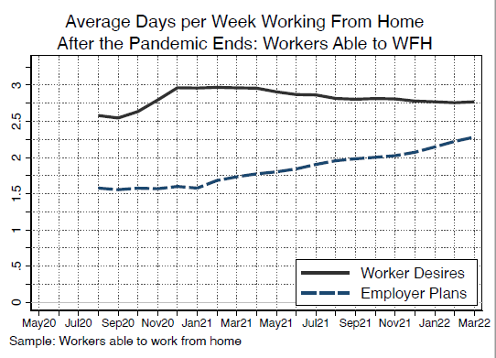
Work from Home and Arbitrage
Another factor that may sustain this housing boom is that higher income workers, who have greater opportunities to Work from Home (WFH), are now able to profit from arbitrage opportunities offered by substantially different home prices within and across metros and regions (especially on a per square foot basis). As employers have become more accepting of WFH, more employees will take advantage of the opportunity (left panel). Nearly ¼ of US households live in metros with an average median home price/median household income ratio of 6.9, while the rest of the country has a ratio of 3.3 (right panel). And WFH buyer incomes are well above average.
Moved From: San Jose-San Francisco-Oakland, CA CSA
Moved To | Median Ratio for Home Bought/Home Sold
Combined Statistical Area (CSA) | AVM* | Price/ Sq. Ft
Boise City-Mountain Home-Ontario, ID-OR | 58% | 43%
Dallas-Fort Worth, TX-OK | 54% | 30%
Denver-Aurora, CO | 68% | 47%
Las Vegas-Henderson, NV | 53% | 37%
Los Angeles-Long Beach, CA | 92% | 73%
Phoenix-Mesa, AZ | 58% | 42%
Portland-Vancouver-Salem, OR-WA | 58% | 38%
Reno-Carson City-Fernley, NV | 60% | 46%
Sacramento-Roseville, CA | 66% | 46%
San Jose-San Francisco-Oakland, CA | 120% | 92%
Seattle-Tacoma, WA | 81% | 56%
* AVM stands for automated valuation model, which estimates a sales price for a given point in time. We use the Dec. 2020 AVM.
Note: table is for about 32,000 traced home sellers that sold homes in the San-Francisco CSA and subsequently bought a new home in the highlighted CSAs in 2020.
Source: Survey of Working Arrangements and Attitudes (SWAA) and AEI Housing Center, www.AEI.org/housing.

Slide 21
Home Price Appreciation Accelerates Despite the Rate Hikes
Despite the recent increase in mortgage rates, rampant home price appreciation continues. In March 2022, the preliminary national year-over-year HPA rate was 16.6%, up from 16.4% in Feb. 2022 and 12.0% a year ago. Since the beginning of 2020, home prices have risen 33%. This rapid pace of HPA is driven by supply constraints (see next slides), relatively low mortgage rates, and an arbitrage opportunity enhanced by the work from home economy. Having entered the spring buying season, HPA is projected to remain in the mid-teens into June 2022 based on Optimal Blue data. Without more inventory or a mortgage rate higher than 6%, y-o-y HPA is expected to remain in the mid-teens for the rest of 2022. December 2022 year-over-year HPA is expected to be 17% with 2023 continuing at a robust 10-12%.
Note: Data are for 30-year fixed-rate prime conventional conforming home purchase mortgages with a loan-to-value of 80 percent.
Source: Freddie Mac.
Note: Data are for the entire country. Data for March 2022 are preliminary.
Source: AEI Housing Center, www.AEI.org/housing.

Slide 22
Home Price Appreciation by Price Tier
Since 2012 a large gap in HPA has developed between the lower and upper end of the market (left panel). Preliminary numbers for March 2022 indicate that the low price tier continues to have strong HPA, but the med-high and high price tiers, which are more dependent on the Fed’s monetary punch bowl for increased buying power from low rates, are showing the strongest HPA (right panel). This is a trend reversal. Since HPA has not yet peaked, it will take a sustained mortgage rate of 6% or more to slow HPA in the med-high and high price tiers. A 6% rate will still lead to an overall 2023 HPA of 10-12%.
Note: Data are for the entire country. Data for March 2022 are preliminary.
Source: AEI Housing Center, www.AEI.org/housing.

Slide 23
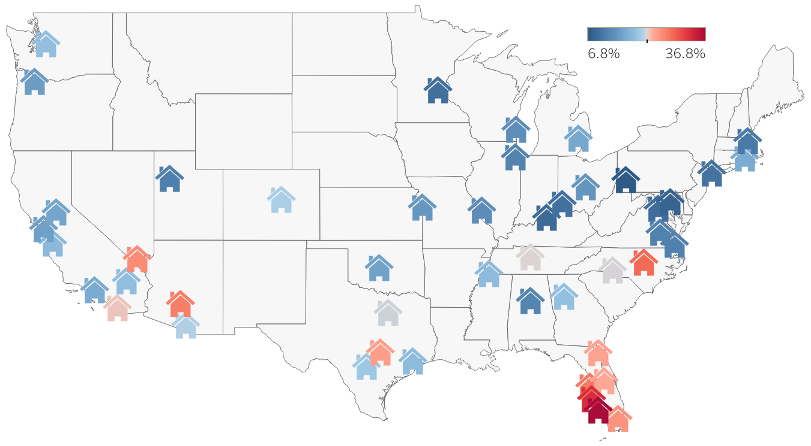
Home Price Appreciation (HPA) by Metro (50 Largest)
While home prices are booming everywhere, metros in Florida (Cape Coral, North Port, Tampa, Miami, Jacksonville and Orlando) and metros effected by California out-migration (Phoenix, Las Vegas, and Austin) are seeing prices rise the most. These metros are attractive destinations for work from home employees looking to take advantage of relatively lower home prices, as well as retirees looking for warmer climates. In these areas, new construction has not been able to keep up with this rapid growth.
Year-over-year HPA (Mar. 2022)
 | YoY HPA
 | Mar. 2022 | Mar. 2020
Highest HPA Metros
Cape Coral, FL | 36.8% | 2.7%
North Port, FL | 32.8% | 4.3%
Raleigh, NC | 28.4% | 6.5%
Tampa, FL | 27.3% | 9.6%
Phoenix, AZ | 26.9% | 11.1%
Lowest HPA Metros
Pittsburgh, PA | 6.8% | 5.9%
Baltimore, MD | 8.0% | 5.4%
Louisville, KY | 8.7% | 6.1%
Washington, DC | 9.1% | 6.5%
Minneapolis, MN | 9.4% | 7.1%
Note: Data are for the largest 50 metros. We rank metros based on their purchase home sales from 2012 to 2019 in the Public Records. Data for March 2022 are preliminary.
Source: AEI Housing Center, www.AEI.org/housing.

Slide 24
Outflow from Large Markets to Smaller Markets Remains High
Outflow from the 25 largest metros to smaller markets has been a long-term trend and is helping to keep house price appreciation strong.
Source: Freddie Mac and U.S. Census Bureau, “Metropolitan and Micropolitan Statistical Area Population Estimates and Estimated Components of Change: April 1, 2010 to July 1, 2019 (CBSA-EST2019-alldata)”, retrieved from https://www.census.gov/data/tables/time-series/demo/popest/2010s-total-metro-and-micro-statistical-areas.html

Slide 25
Home Price Appreciation (HPA) by Walk Score Quintile:
Largest 100 Metros
Before the pandemic, people were willing to pay up for the utility provided by locations with a high level of walkability (ie. the ability to complete most of life’s daily errands on foot as measured by Redfin’s Walk Score®). Pre-pandemic (2012:Q1 through 2020:Q1), home price appreciation (HPA) in the most walkable quintile of each of the 100 largest metros averaged 7.2% (yoy), but only 5.9% (yoy) in the least walkable quintile. With the onset of the pandemic, the trend first narrowed, then flipped, and the least walkable quintile is appreciating at an average of 13.1% (yoy), while the most walkable quintile is appreciating at 11.2% (yoy).
Average YoY HPA | Least Walkable | Middle | Most Walkable
Before Pandemic (2013:Q1-2020:Q1) | 5.9% | 6.5% | 7.2%
From Pandemic onward (2020:Q2-2022:Q1) | 13.1% | 12.7% | 11.2%
Source: Walk Score and AEI Housing Center, www.AEI.org/housing.

Slide 26
Supply Remains Depleted, Likely Fueling Continued Rapid HPA
  Active listings set a series’ low for the month of March (left), down 19% from the already depleted levels of 2021 and only about 1/3 of 2017-2020 levels. This does not bode well for entry-level buyers this spring buying season, with home price appreciation likely staying in the mid- to upper-teens. Supply is the most depleted in less dense areas (right). For the foreseeable future, it will be difficult to replenish or increase supply since: (i) more baby boomers are staying put, (ii) it takes time to acquire land, title, and to build even in places like North Carolina and Texas, which are also growing rapidly, and (iii) adding supply will face the usual difficulties in the Northeast and much of the West.
Change in Active Listings by Density (Mar. 2022 compared to Mar. 2020)
Density Quintile | Nation | LA | NYC
All | -63% | -53% | -41%
1 (least) | -63% | -57% | -69%
2 | -68% | -57% | -66%
3 | -69% | -52% | -43%
4 | -65% | -43% | 1%
5 (most) | -37% | -31% | 66%
Change in Active Listings by Price Tier (Mar. 2022 compared to Mar. 2020)
Overall | Low | Low-Med | Med-High | High
-63% | -62% | -65% | -62% | -61%
Source: Realtor.com, Census Bureau, and AEI Housing Center, www.AEI.org/housing.

Slide 27
Months’ Supply by Price Tiers
  Starting in June 2020, months’ supply started to drop precipitously across all price tiers and remains at or near the series’ lows. In March 2022, overall months’ supply stood at 0.9 months. While supply remains lowest in the low (0.6 months) and low-med tiers (0.8 months), the drop in the med-high and high price tiers is especially noteworthy. The high tier has fallen from 9.4 months in May 2020 to 2.2 months in March 2022, while the med-high tier has fallen from 4.2 to 1.2.
Note: Months’ supply measures how long it would take for the existing level of inventory to be sold off at the current sale’s pace. While the listings data come from the MLS, the sales numbers come from the public records.
Source: Realtor.com, Zillow, and AEI Housing Center, www.AEI.org/housing.

Slide 28
GSE Use of Appraisal Waivers Has Exploded since Mid-2019
The share of appraisal waivers for both GSEs combined for February 2021 stood at 30%, down 19 ppts. from its series’ peak in March 2021 (left chart). This decline is largely due to a share shift away from refinance loans, for which waiver usage is more prevalent (right chart). There is also a decline in waiver usage by product type. Waivers are granted using a data based analysis of the reasonableness of the applicant’s self valuation. The data measure whether an appraisal waiver was used, not only granted, on the loan. The GSEs will be accepting hybrid appraisals as of March 19, 2022 and we have requested clarification as to how they will be reported.
Note: For the appraisal waiver charts, we are assuming a one month shift between first payment date and origination date. Data are for February 2022.
Source: AEI Housing Center, www.AEI.org/housing.

Slide 29
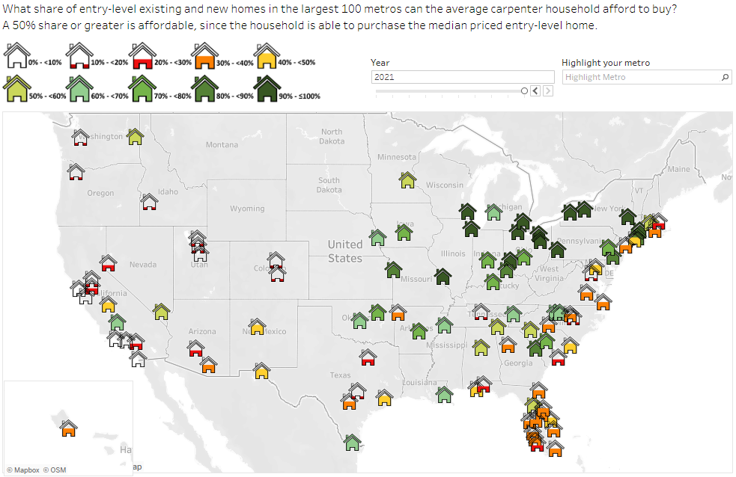
The Carpenter Index in 2021
The Carpenter Index combines both local wages and home prices into an affordability measure for blue-collar employees. Specifically, the index assumes a price-to-income ratio of 3:1 to determine affordability, meaning that a household earning $60,000 can afford a home worth $180,000. In 2021, Oxnard ranked as the least affordable metro, while there was a tie among mostly Midwestern metros for the most affordable metro. There is some good news on the affordability front. A number of the top 100 metros have a Carpenter Index of ≥50% and growth of 5,000 or more in population from 2020 to 2021: Las Vegas, Indianapolis, Oklahoma City, Knoxville, Greenville, SC, Columbus, Ocala, FL, Des Moines, McAllen, TX, Bakersfield, Columbia, SC, Tulsa, Spokane, Kansas City, Winston-Salem.
To view the index, click here.
In 2021, 56 of the 100 largest metros were not affordable for the average carpenter household.
In 2012, this was the case for 6 of those 100 metros.
Top 10 Metros
1 Toledo, OH | 1 Buffalo, NY
1 Cleveland, OH | 1 St. Louis, MO
1 Akron, OH | 1 Rochester, NY
1 Dayton, OH | 9 Detroit, MI
1 Pittsburgh, PA | 10 Hartford, CT
Bottom 10 Metros
100 Oxnard, CA | 95 San Francisco, CA
99 Los Angeles, CA | 94 Ogden, UT
98 San Diego, CA | 93 Salt Lake City, UT
97 San Jose, CA | 92 Boise City, ID
96 Provo, UT | 91 Sacramento, CA

Slide 30
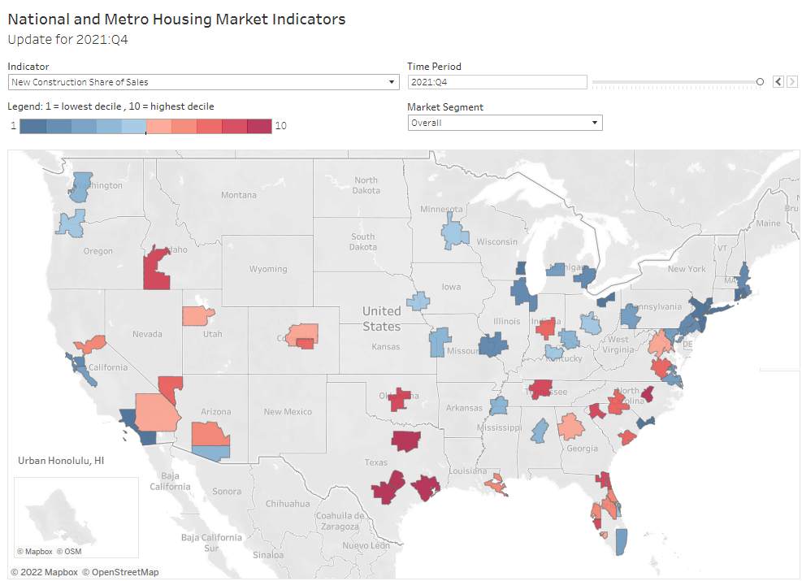
National and Metro Housing Market Indicators: 2021:Q4 Update
Housing markets are inherently local, making them notoriously difficult to analyze due to the lack of reliable and detailed local data. The National and Metro Housing Market Indicators dataset fills this void by analyzing housing market data for the 60 largest US metropolitan areas, as well as for the nation as a whole. The current dataset has been updated through 2021:Q4.
Metrics covered include:
Home price appreciation,
Months’ supply,
Sale prices,
Mortgage risk, and
New construction share of sales.
Source: AEI Housing Center, www.AEI.org/housing.

Slide 31
We Have a Position Open for Either a (Senior) Data Analyst or a (Senior) Research Analyst
Final title and salary are commensurate with experience.
Candidates for either Data Analyst title will hold a Bachelor’s with at least 2 years of professional experience in the field or Master’s degree in economics, public policy, finance, real estate, or data science. The ability to work effectively in a team environment, combined with strong quantitative, communication, and organization skills is required.
  Knowledge of Stata, Python, Excel, and Tableau (essential)
  Knowledge of SAS, R, or ArcGIS (desirable)
  Experience with a heavy concentration of programming and database course work or comparable experience.
-------
Candidates for either Research Analyst title will hold a Bachelor’s with at least 2 years of professional experience in the field or Master’s degree in economics, public policy, finance, real estate, or data science. The ability to work effectively in a team environment, combined with strong analytical, communication, and organization skills is required.
  Knowledge of Excel (essential)
  Knowledge of Tableau or ArcGIS (desirable)
  Ability to write policy reports (desirable)
Please click here to apply.

Slide 32
Remaining Briefing Dates for 2022
Our next HMI briefing is on Tuesday, May 31, 2022.
The briefings for 2022 are listed below:
Tuesday | May 31, 3022
Tuesday | June 28, 2022
Tuesday | August 2, 2022
 | No late August briefing
Wednesday | September 28, 2022
Tuesday | November 1, 2022
Tuesday | November 29, 2022
Tuesday | January 3, 2023
All briefings take place at 11 AM ET.
If you know someone not on our regular distribution list and who would like to be added to it, please send them this link.

Slide 33
Methodology

Slide 34
National Mortgage Default Rate (NMDR):
A Quick Primer
Overall goal:
  Monitor market stability through accurate, real-time tracking of leverage that, if left unchecked, would result in destructive housing booms/busts.
Principles behind the NMDR
  NMDR is a stress test, similar to a car crash safety rating or hurricane rating for buildings.
  The NMDR’s stress event is the financial crisis from 2007.
Basics of index construction
  The NMDR is a standardized quantitative index for mortgage risk (leverage)
  Places loans in risk buckets and assesses default risk based on the performance of the 2006-07 vintage loans with similar characteristics
Advantages of the NMDR
  Near-complete census of gov’t-guaranteed loans,
  Accurate, timely, and in-depth coverage of purchase mortgage trends
  NMDR provides significant signals of market trends without the noise of other indices
Difference to the prior National Mortgage Risk Index (NMRI)
  The NMRI was based on the performance of Freddie loans originated in 2007 through the end of 2012
  The NMDR is based on GSE, FHA, PLS, Portfolio and VA loans originated in 2006-07 through 2019.
What does an increasing or decreasing NMDR mean?
  Increasing NMDR = increasing leverage = looser lending
  Decreasing NMDR = decreasing leverage = tighter lending

Slide 35
Stressed Default Rates, Home Purchase Loans
Risk Bucket | Credit Score | CLTV | Total DTI | Default Rate
Very Low | ≥ 770 | 61-70% | ≤ 33% | 1.1%
Low | 720-769 | 76-80% | 34-38% | 6.3%
Medium | 690-719 | 81-85% | 39-43% | 10.7%
High | 660-689 | 91-95% | 44-50% | 24.1%
Very High | 620-639 | > 95% | > 50% | 56.2%
Note: Default rates represent cumulative defaults through 2019 for 2006-07 vintage loans. The loans included in the calculation are all primary owner-occupied, 30-year fixed-rate, fully amortizing, fully documented, home purchase Enterprise loans.
Takeaway: Huge spread of default rates across risk buckets
Default rates are calculated separately for home purchase loans, rate-and-term refinance loans, and cash-out refinance loans by market segment (FHA, Enterprise, PLS, and VA).
Additional loan risk factors are applied to investor loans, second homes, 15 year terms, and 20 year terms.

Slide 36
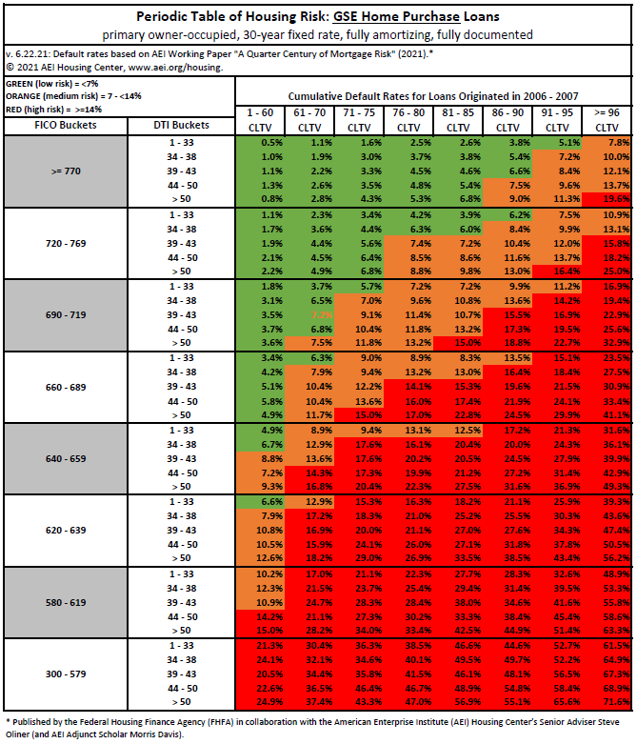
The Stressed Mortgage Default Rate (MDR)
The Periodic Table represents historical stressed MDRs for the cohort years 2006-2007 calculated through 2017, which represents the worst-case scenario stress test similar to a car crash test or a hurricane safety rating.
The stressed MDR captures most relevant risk characteristics at origination: combined loan-to-value (CLTV), credit score, debt-to-income ratio, loan term, loan type, and tenure.*
Advantages of the MDR:
Takes into account risk layering.
Is both straightforward and easy to implement.
Builds on FHFA’s own research.
All data elements used to select the applicable stressed MDR for all loans are common and known at origination.
Superior to many compensating factors that are opinion based, lack rigorous empirical support, or fail to take into account risk layering.
We propose setting a maximum MDR of 14%
This keeps credit available while promoting sustainable homeownership through faster equity accumulation.
  Because MDR limits increase in conjunction with shorter loan terms, borrowers that would otherwise be unable to qualify with a hard DTI limit, could be able to qualify for a mortgage when opting for a shorter term.
MDR limit is counter-cyclical, meaning they provide friction during a boom and room to ease during a bust.
  During a boom, this would help keep home prices from increasing much faster than wages, particularly for entry-level borrowers.
  During a bust, the limit would be unchanged, thereby allowing more normal credit terms to be available as the recovery progresses.
*The additional risk factor multipliers are for loans with a 15- or 20-year loan term, loans with a 40-year loan term, loans for a second home, and loans for an investor home. These factors are available by loan type.

Slide 37
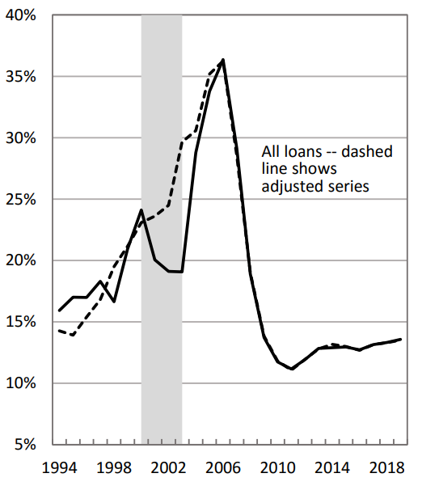
A Quarter Century of Mortgage Risk: FHFA and AEI Housing Center Publish First-of-its-Kind Comprehensive Dataset Covering 1990-2019
This seminal work done in collaboration between the FHFA and the Housing Center’s Senior Adviser Steve Oliner (and AEI Adjunct Scholar Morris Davis) will improve researchers, policymakers, and the public’s understanding of how mortgage risk has evolved from the early 1990s to the present and the role played in the housing boom, subsequent bust, and the 2008 recession.
The authors’ use a comprehensive dataset of more than 200 million purchase-money and refinance mortgages from 1990 to 2019 to “evaluate a common held view that the early 2000s represent a normal period in the mortgage market, a benchmark by which to assess whether lending standards in other periods are loose or tight.” The study documents that mortgage risk started accumulating in the mid-1990s and continued until the peak was reached in 2006-2007. Previous research could not identify the fact that a refinance boom from 2000-2003 masked the mortgage risk accumulation.
The size and scope of the expanded dataset is unprecedented in completeness, accuracy and comprehensive historical information on mortgage risk. The paper is available here.
Source: FHFA and AEI Housing Center, www.AEI.org/housing.

Slide 38
Stressed MDRs are Highly Correlated to Post-Financial Crisis Default Rates
  Stressed MDRs, calculated solely on the basis of loan characteristics present at origination, are highly predictive of default rates both in a non-stress delinquency environment (R-squared is 96%) and in a stress delinquency environment (R-squared is 99.9%), even though the size and nature of the pandemic is fundamentally different from the financial crisis.
  The MDR was equally predictive of defaults for any given loan type.
Source: AEI Housing Center, www.AEI.org/housing.

Slide 39
Comparing the MRI and the new Stressed MDR
The FHFA study utilized what is considered to be the best available data: Fannie Mae and Freddie Mac loan data maintained by FHFA and FHA, VA, private portfolio, and private MBS data maintained by the Housing Center. For the Stressed MDR, the FHFA paper builds and expands on the concepts pioneered in 2013 by the Mortgage Risk Index (MRI ). Here are key features:
 | MRI | MDR
Concept: a stressed default measure | Measures how the loans originated in a given month would perform if subjected to the same stress as loans originated prior to the start of the Financial Crisis.
Universe of loans to create the Periodic Table: | Only loans originated in 2007, prior to the start of the Financial Crisis, from data publicly released by Freddie Mac. However, this data set was heavily ‘censored’. | Combines loans originated in 2006/07 (since both performed about equally poorly) of GSE, FHA, VA, portfolio, and private MBS loans from the most complete data sources available.
Number of risk buckets: | 320 (based on a combination of credit score, CLTV, and DTI buckets) | 320 (based on a combination of credit scores, CLTV, and DTI buckets)
Agency specific Periodic Tables: | MRI applies the Freddie periodic table to Fannie, FHA, RHS, and VA. For VA loans, we assume a risk haircut of 40%, which is consistent with the literature. | Periodic tables are constructed for each agency with the exception of RHS. (We apply the GSE table to RHS.)
Default occurrences are measured through: | December 31, 2012 | December 31, 2019
Refinance risk buckets: | Limited to 80 (Cash-out) and 100 (No cash-out) risk buckets. | Using the combined 2006/07 cohorts, expanded data sources, and inclusion of substantial ‘censored’ data for 2006/07, it uses the same 320 risk buckets as for purchase loans.

Slide 40
Comparing the MRI and the new Stressed MDR (cont.)
The Stressed MDR and MRI follow nearly identical trends. Since the Stressed MDR allows for a longer time period for loans to default (through 2019 compared to 2012 for the MRI), the level of default risk is higher than the level of the MRI. We will soon phase out the MRI and switch over to the MDR in our reporting of underwriting standards.
Charts updated through Feb-21 only.
Source: AEI Housing Center, www.AEI.org/housing.

Slide 41
Price Tier Methodology
Goal: create leverage-based price tiers.
Rationale: segmenting the market by price tier is important because housing policies, new construction activity, and access to leverage vary by these price tier. Thus, these factors can create very different home price appreciation trends depending on the price tier.
4 Price Tiers:
  Low: all sales below the 40th percentile of FHA sales prices
  Low-medium: all sales at or below the 80th percentile of FHA sales prices
  Medium-high: all sales at or below 125% of the GSE loan limit
  High: all other sales
Data Inputs:
  Public Records (near-real time with latency and coverage problems).
  FHA Snapshot (monthly dataset of all FHA endorsements; released around mid-month with a one month lag).
  FHFA loan limits at the county level.
Assumptions and Construction:
  On average, the difference between loan origination and endorsement is one month (we have confirmed this on aggregate by comparing monthly FHA Snapshot to NMDR counts).
  Price Tiers are set quarterly at the metro level. When there are fewer than 50 FHA loans in a quarter, we pool all FHA loans at the non-metro state level.
  For the demarcation between medium-high and high tier, we multiply a perspective's county loan limit by 1.25 to account for an 80% LTV, which is the median LTV of loans taken out at the loan limit.
Result:
2018 | Price Tier |  |  |  | Overall
 | Low | Low-Med | Med-High | High
Mortgage Risk Index | 16.0% | 14.6% | 8.8% | 3.2% | 11.2%
Market Share* | 26% | 28% | 38% | 7% | 100%
*For institutionally financed sales. May not add to 100% due to rounding.

Slide 42
House Price Appreciation (HPA) Index: A Quick Primer
Overall goal:
  Monitor market stability through accurate, real-time tracking of house prices.
Basics of index construction
  Most widely known HPA Indices are repeat sales (i.e. Case Shiller or FHFA) or hedonic (Zillow).
  AEI’s HPA is a “quasi” repeat sales index.
  Index measures HPA by constructing an artificial sales pair consisting of one actual sale and one “artificial” sale as measured by the property’s Automated Valuation Model (AVM).
  The AVM approximates a property’s sale price at a given point in time. The AVM used has been evaluated by us and has been found to be, on average unbiased and accurate (meaning that it has a normal error distribution).
Advantages of AEI’s HPA Index
  Combines the best of repeat and hedonic models.
  Unlike a repeat sales index, which is limited to repeat sales and may therefore be biased, AEI’s index includes the entire universe of sales.
  Unlike a hedonic index, which incorporates every property (even unsold ones), it reduces the amount of errors since at least one sale of the transaction pair actually occurred.
  Allows for an index construction by price tier and fine geographic levels (down to census tract).
Data for the HPA index
  National Public Records data and AVM for Dec-2018 come from First American via DataTree.com.
  Uses virtually all institutionally financed sales back to January 2012.
  Data are weighted at the county level to make them representative.
  HPAs for the medium-high and high price tiers are spliced around the time of loan limit changes.
AEI House Price Appreciation Indexes are published nationally and by price tier
  The four tiers are set at the metro level and adjusted quarterly (see: Price Tier Methodology slide) .
  HPAs are smoothed around the times of FHFA loan limit changes.
Revisions with public records data are standard, and to ensure accuracy, the AEI Housing Center incorporates the newly released public data to provide updated results.
  Data for the most recent month are preliminary.

Slide 43
Home Sales Methodology
Data Inputs
  Public Records (near-real time with latency and coverage problems).
  HMDA (annual dataset of institutionally financed sales (IFS); covers around 99% of loans; released with lag).
  FHA Snapshot (monthly dataset of all FHA endorsements; released around mid-month with a one month lag).
  National Mortgage Risk Index (NMDR) (covers 99% of Agency loans; two months lag).
Assumptions
  Recorder offices process transactions in random order; latency in reporting applies equally across all sales types.
  FHA loans are properly recorded (stamp on mortgage document).
  On average, the difference between loan origination and endorsement is one month (we have confirmed this on aggregate by comparing monthly FHA Snapshot to NMDR counts).
  Conventional loans have same seasonal pattern as GSE loans.
Construction
  Aggregation from the county level up.
  Use FHA Snapshot for all FHA sales.
  When HMDA is available: Use HMDA for remaining IFS when available:
    Impute cash and other financed sales as a percentage of IFS (assume state average for counties with latency problems);
    Impute seasonal pattern from either public records or NMDRI.
  When HMDA is not yet available: Use Public records with adjustments:
    Limited to ~ 700 counties that account for ~80% of sales (remove counties with insufficient FHA counts or breaks in series);
    Gross up all sales in that county by the ratio of FHA Public Records loans to FHA Snapshot loans;
    Assume same rate of change for ~2400 counties with ~20% of sales -> still working on improving this assumption.
    As a robustness check of this, we compare state VA and RHS totals to the NMRI and adjust totals.

Slide 44
New Construction Identification (NC) Methodology
Data Inputs
  Public Records (Deed & Assessor files)
  Zillow API and/or Listings data
Identification of NC
  Year Built in Assessor data
  If Year Built is missing:
    Seller name (we have assembled a list of over 400 builders with their subsidiaries and key words to identify smaller builders.) If a seller is a builder and the Year Built is missing, then it is most likely a new construction that has not yet been assessed.
    Ping Zillow API for Year Built and Use Code. Data not perfect, along with other data helps determine status.
    Sellers with multiple sales that are not individuals/gov’t/lender/other corporation are most likely builders (relatively small number).
  Count only first sale of home as a new construction.
Verification – Quality Control, Quality Control, Quality Control
  Random sampling and checking of new constructions and existing homes using Zillow data, Google street view/satellite images.
  Find 2% false positives and 1% false negatives.
  Builder example: AEI NC found 93% of DR Horton sales (unweighted) and 105% (weighted)
Final dataset allows us to:
  Monitor new constructions at the property level,
  Accurately estimate new home sales at fine geographic levels when combined with Home Sales #s,
  Estimate additions to the existing housing stock when combined with Assessor data,
  Estimate sales by builder and track builder, and
  Combine new construction numbers with Months’ Supply and house price appreciation.
Other considerations
  Lag in data; originally estimated at ~4 quarters; with more data processed, looks like 1-2 months.
  Hard to identify owner-built homes without a long lag.

Slide 45
AEI-adjusted Land Prices and Land Shares Methodology
Methodology
AEI-adjusted land price and land share indicators are based on data for 2012 from “The Price of Residential Land for Counties, ZIP Codes, and Census Tracts in the United States” ​by Davis (Rutgers), Larson (FHFA), Oliner (AEI), and Shui (FHFA). However, due to potential biases (anchored to tax assessments and a limitation to GSE appraisals), the Davis et al. data likely understate the amount of home price appreciation and, by extension, the amount of increase in land prices. Therefore, we enhance the Davis et al. data using AEI’s constant-quality home price appreciation index.
How exactly is the AEI adjustment done?
The AEI-adjusted data use the 2012 land prices and shares from the Davis et al. paper as a stake in the ground. These values are then rolled forward in time using various AEI and CoreLogic metrics and assumptions.
Data:
AEI constant-quality HPA series: This is an annual series for each ZIP code indexed to 0 in 2012.
AEI’s public records dataset: We use the 2012 average sale price for each ZIP code.
CoreLogic’s Construction Cost Index: This is an annual series for each three-digit ZIP code.
Assumptions:
The structure value in 2012 is approximated using the 2012 land share from the Davis et al. dataset and AEI’s average sale price.
The structure value is rolled forward using CoreLogic’s Construction Cost Index on three-digit ZIP code level.
The average sale price is rolled forward using its 2012 value and the constant-quality HPA series.
The land share for any year is calculated as the difference between 100% and the ratio of that year’s adjusted structure value and adjusted average sale price. Once a year’s land share for a ZIP code is known, we adjust the 2012 land prices according to the changes in the land share over time.
Detailed methodology can be found here: https://www.aei.org/wp-content/uploads/2021/05/AEI-adjusted-Land-Price-and-Land-Share-Indicators-Methodology.pdf?x91208

Slide 46
AEI Market Indicator Nowcast using Optimal Blue Data
  The AEI Housing Center is providing near-real time Flash Housing Market Indicators (HMI) during the coronavirus (COVID-19) era. Released each Monday, the Flash HMIs will provide weekly insights on:
    house prices,
    credit underwriting standards,
    purchase and refinance origination trends
    cash out amounts, and
    much more.
  What is the significance
    The Flash Housing Market Indicators reports are possible thanks to newly acquired data from Optimal Blue, a rate lock software provider with roughly a third market coverage.
    After extensive historical analysis of Optimal Blue data going back 7 years, we have concluded that these rate lock data track closely those reported in our National Mortgage Risk Index (NMDR), which cover 99% of the agency market.* As a result, the HMIs enhanced with Optimal Blue data provide an advance look trends which will not be reported in our NMDR until 3 months later. In terms of home price appreciation trends, the data also would not be available until 3 months later and would be reported on a monthly basis.
  The Housing Market Nowcast will provide much-needed and timely insights on the single-family residential housing market convulsing from the effects of the coronavirus pandemic.
  The Housing Market Nowcasts are available on our website here.
  * While not all rate locks will be originated or the Optimal Blue data cover the entire market, our analysis of the data has found them to be instructive as the changes over short time periods provide a useful signpost for what’s to come. While Optimal Blue data is used, Edward Pinto and Tobias Peter are solely responsible for the analysis.

Slide 47
House Price Appreciation (HPA) Trend Comparison
A simplified HPA regression using Optimal Blue data seems to fairly accurately predict HPA trends, while also providing a window in the future. There is a small level difference between both series.
Note: Based on purchase price estimates from rate lock data and their geographic location, we construct a weekly home price appreciation index. The index estimates an average weekly sale price controlling for location at the ZIP code level. The data are weighted by county, loan type, and year using HMDA data to account for differences in coverage of the Optimal Blue data. For the years for which HMDA data are not yet available, we assume the same weight as for 2018. This index largely replicates the findings of our constant-quality quasi repeat sales home price appreciation index available here. Optimal Blue’s data coverage has improved over the years, which is reflected in the closer alignment in levels over time.
Source: AEI Housing Center, www.AEI.org/housing and Optimal Blue.

Slide 48
List of Abbreviations
Term | Description
MDR | The Mortgage Default Rate (MDR) measures how the loans originated in a given month would perform if subjected to the same stress as loans originated in 2006/2007, which experienced the highest default rates as a result of the Great Recession.
NMDR | The National Mortgage Default Rate (NMDR) currently covers home purchase and refinance loans (except for VA refinances) that have been (1) acquired and securitized by Fannie Mae or Freddie Mac or (2) insured or guaranteed by the Federal Housing Administration (FHA), the Department of Veterans Affairs (VA), or the Rural Housing Service (RHS).
SMDR | The State-level Mortgage Default Rate (SMDR) measures mortgage risk on a state level. It employs exactly the same stress-test methodology as the national index.
FBMSI | The First-time Buyer Mortgage Share Index (FBMSI) equals the number of loans made to first-time buyers divided by the number of all home purchase loans excluding those made to investors and second home buyers for any given month (see first-time buyer (FTB) definition below). The agency FBMSI covers government-guaranteed loans, while the combined FBMSI covers both government-guaranteed and private-sector loans. The agency loans are from the same database used for the NMDR, while the private-sector component of the combined FBMSI come from AEI’s National Housing Market Index (NHMI) and assumptions believed to be reasonable.
FBMDR | The First-time Buyer Mortgage Default Rate (FBMDR) is calculated using the same methodology as for the NMDR. The only difference is that the set of included loans is restricted to first-time buyers.
FTB | AEI uses the federal government’s definition of a first-time homebuyer (FTB). A FTB is an individual borrower who (1) is purchasing the mortgaged property, (2) will reside in the mortgaged property as a primary residence, and (3) had no ownership interest (sole or joint) in a residential property during the three-year period preceding the date of the purchase of the mortgaged property. Investment properties, second homes, and refinance transactions are not eligible to be considered first-time homebuyer transactions. Other organizations such as the National Association of Realtors (NAR) use a different definition of FTB based on self-identification.
RB | Repeat Buyers (RB) are all home buyers that are not first-time buyers.

Slide 49
List of Abbreviations (cont’d)
Term | Description
GSE | A Government-Sponsored Enterprise (GSE) is an entity created by Congress that operates under a government-defined mission and charter. There are two housing-related GSEs: Freddie Mac and Fannie Mae. They purchase mortgages on the secondary market and subsequently pool them into mortgage-backed securities (MBS), which are purchased by government and private investors.
Fannie Mae | The Federal National Mortgage Association (FNMA), known as Fannie Mae, was founded in 1938 as part of the New Deal legislation.
Freddie Mac | The Federal Home Loan Mortgage Corporation (FHLMC), known as Freddie Mac, was created in 1970 to complement Fannie Mae.
Ginnie Mae | The Government National Mortgage Association (Ginnie Mae) is a federal government corporation that aims to promote homeownership for low- and moderate-income families. It ensures the timely payment of principal and interest on mortgage-backed securities formed from mortgages that are guaranteed or insured by FHA, VA, RHS, or smaller programs for Native Americans. Ginnie Mae was created in 1968. Prior to 1968 its role was performed by Fannie Mae.
FHA | The Federal Housing Administration (FHA), founded in 1934, is a federal agency that today provides mortgage insurance for residential loans made to high-risk borrowers. The borrower pays an upfront mortgage insurance premium as well as monthly insurance premiums for the service. In return, FHA covers 100% of the lender’s loss in case of the borrower’s default.
RHS | The Rural Housing Service (RHS) is a program within the U.S. Department of Agriculture that guarantees mortgages in rural areas. The borrower pays an upfront annual fee for the service. In return, RHS covers 100% of lender’s loss in case of the borrower’s default.
VA | The Department of Veterans Affairs (VA) guarantees mortgages to eligible veterans and generally pays 25% of lender’s loss in case of the borrower’s default. The borrower pays an upfront annual fee for the service.
HUD | FHA has been overseen by the Department of Housing and Urban Development (HUD) since its creation in 1965.

Slide 50
List of Abbreviations (cont’d)
Term | Description
FICO® | The FICO Credit Score is a statistical credit evaluation score developed by Fair, Isaac and Co. The FICO score attempts to measure a borrower’s risk of default through his or her personal financial history. FICO scores range from a high default-risk score of 300 to a low default-risk score of 850. The term “credit score” is used to connote a generic score.
LTV / CLTV | The Loan-to-Value Ratio (LTV) is the ratio of the 1st lien loan amount to the property’s value. Since the down payment on a purchase transaction is the property’s value minus the loan amount, the LTV is inversely related to the down payment. The Combined Loan-to-Value (CLTV) is the ratio of all loan amounts at 1st lien origination to the property’s value. Both ratios are a measure of a borrower’s skin in the game.
DTI | The total Debt-to-Income Ratio (DTI) gauges the ability of a borrower to repay a mortgage by measuring the amount of income consumed for repayment of all outstanding debts of the borrower.
ARM | An Adjustable-Rate Mortgage (ARM) is a mortgage whose interest rate varies over the lifetime of the loan based on market conditions. ARMs have on average a higher default risk than FRMs.
FRM | A Fixed Rate Mortgage (FRM) maintains the interest rate at origination throughout the lifetime of the loan.
MSA | A Metropolitan Statistical Area (MSA) is a geographical region with a population of at least 50,000 inhabitants at its core and close economic ties throughout the region.
PCE price index | The Personal Consumption Expenditure (PCE) price index measures the prices of goods and services purchased by consumers in the U.S. economy. It is published monthly by the Bureau of Economic Analysis in the Department of Commerce. The PCE price index is the measure of inflation targeted by the Federal Reserve.
SLOOS | The Senior Loan Officer Opinion Survey on Bank Lending Practices (SLOOS) is a survey of lending conditions conducted quarterly by the Federal Reserve among roughly eighty large domestic banks and twenty-five U.S. branches and agencies of foreign banks.

Slide 51
List of Abbreviations (cont’d)
Term | Description
QM/QRM | The Qualified Mortgage (QM) and the Qualified Residential Mortgage (QRM) are mortgage terms created under the Dodd-Frank Act. A mortgage that meets the QM requirements provides legal protection for lenders against a claim that the loan was made without due consideration of the borrower’s ability to repay. The QRM designation relates to the securitization of mortgages. If the loans in a mortgage-backed security are QRMs, the securitizing agent is not required to retain any risk position in the security. Although the initial proposed QRM definition was relatively strict, the final definition was watered down to be equivalent to the looser QM definition. The five guarantee agencies (Fannie Mae, Freddie Mac, FHA, VA, and RHS are exempt from substantial portions of the QM rules and entirely from the QRM rules. (For Fannie and Freddie, this exemption applies only while they are in conservatorship).
MIP | The Mortgage Insurance Premium (MIP) is a payment to compensate for the risk of default on the mortgage. As noted above, FHA mortgages carry both upfront and monthly MIP payments. Fannie Mae and Freddie Mac generally require mortgage insurance for loans they guarantee with LTVs above 80%; borrowers with these GSE-guaranteed loans may make monthly MIP payments depending on the premium plan.
TRID | The TILA-RESPA Integrated Disclosure (TRID) rule – commonly also known as Know Before You Owe – requires lenders to summarize and more prominently display the loan terms on the mortgage form. It also institutes a three-day waiting period before closing to allow borrowers time to review the contract. The form change is currently suppressing sales volume as it is delaying loan closings by creating additional burdens on lenders. TRID was mandated by the Consumer Financial Protection Bureau (CFPB) and applies to mortgage applications filed on or after October 3, 2015.
APOR | The average prime offer rate (APOR) is a weekly survey-based estimate of the Annual Percentage Rates (APRs) of “best quality,” 80% LTV, first-lien loans. The APOR is available for (1) 30-year fixed-rate; (2) 15-year fixed-rate; (3) five-year variable-rate; and (4) one-year variable-rate loan products.
Rate Lock | A rate lock is an agreement between a borrower and a lender which guarantees that the mortgage will be available to the borrower at a specific interest rate for a certain amount of time. All rate locks reported on in this briefing are made using Optimal Blue, a rate lock software provider covering roughly a third of the market.

