Slide 2
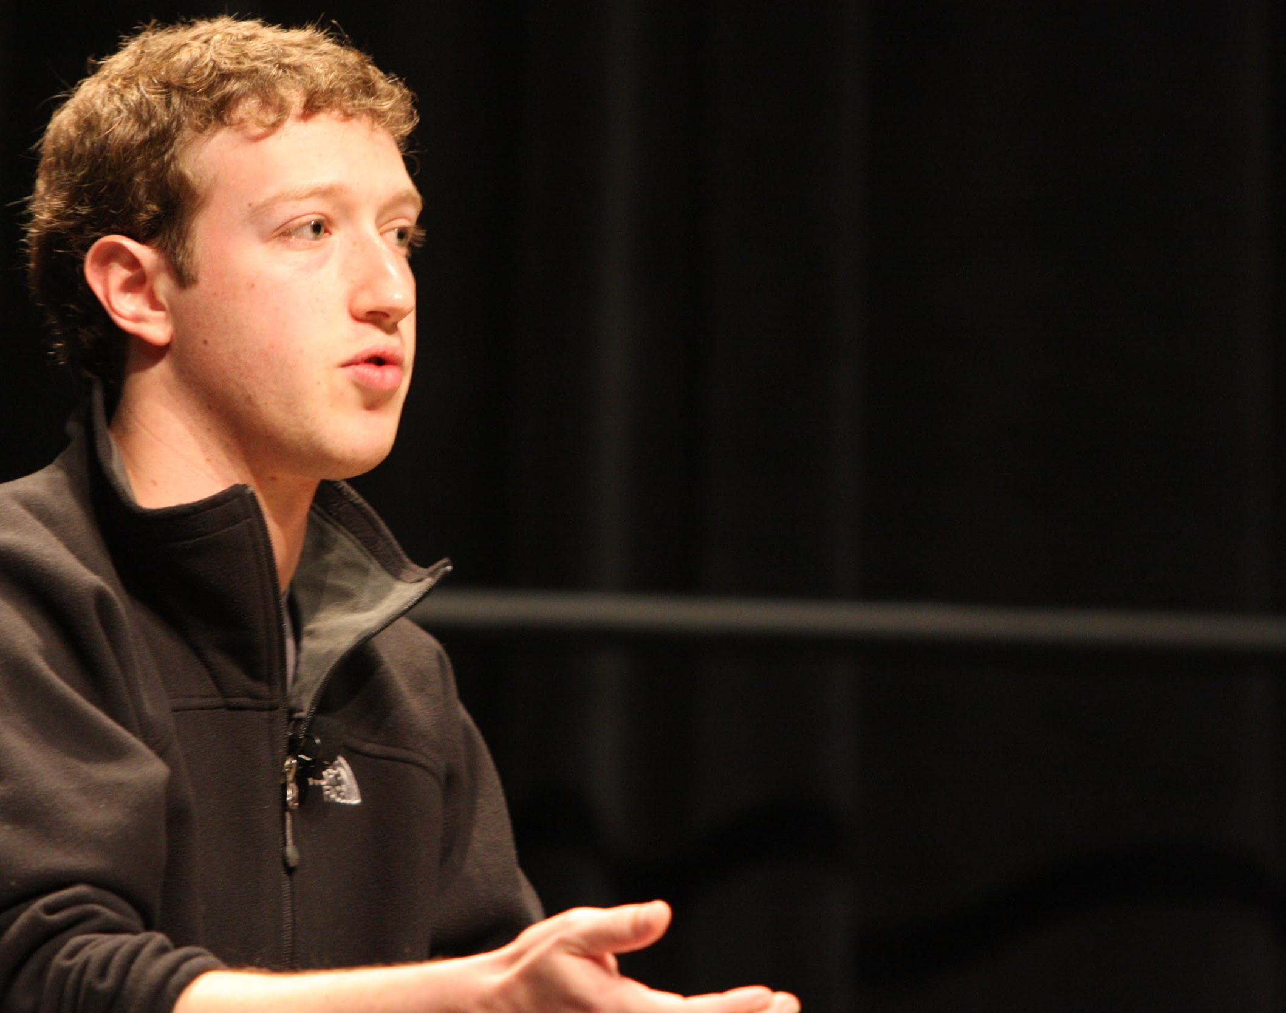
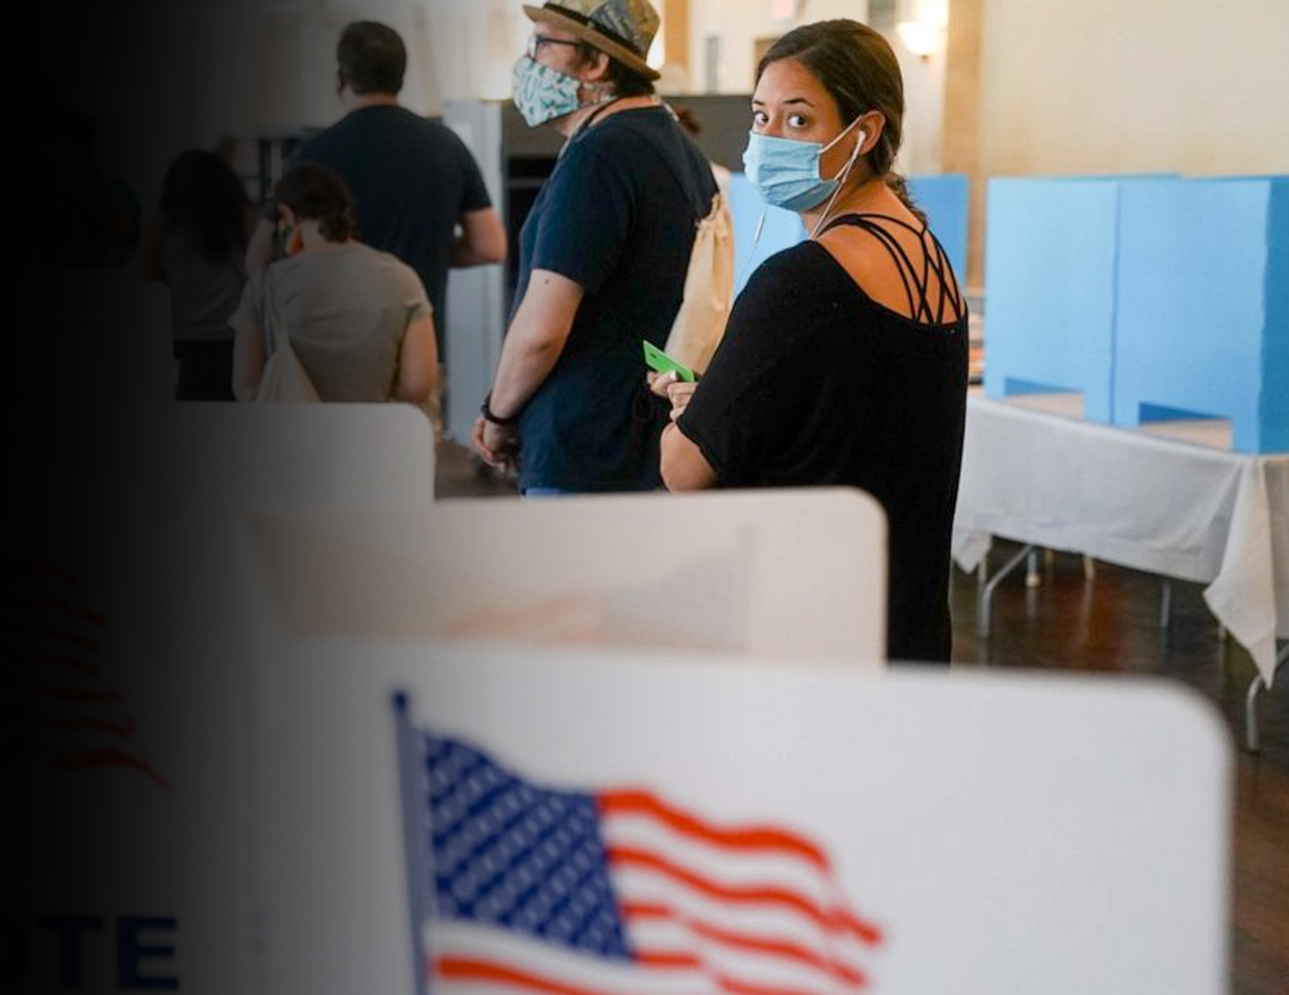
ZUCKERBERG
ELECTION MEDDLING
EXPOSED
December 16th, 2020

Slide 3
CONFIDENCE
IN 2020 ELECTION

Slide 4
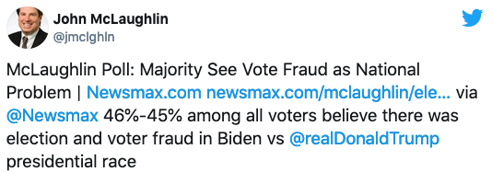

Slide 6
Arizona Senate will subpoena Maricopa County for election audit
December 14, 2020
“Amid false claims of election fraud spread by President Donald Trump and Arizona Republican leaders, the Arizona Senate will issue subpoenas to inspect and audit ballot counting machines in Maricopa County, a top Republican senator announced Monday at the conclusion of a six-hour-long legislative hearing into the November election.”

Slide 7
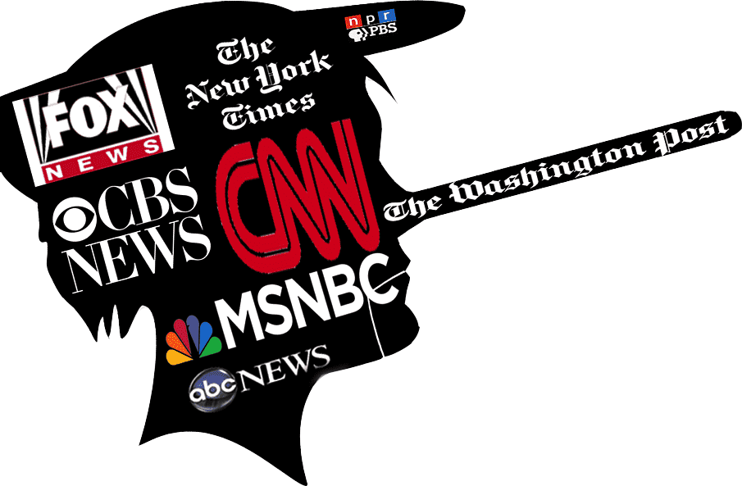

Slide 8
EVIDENCE

Slide 10
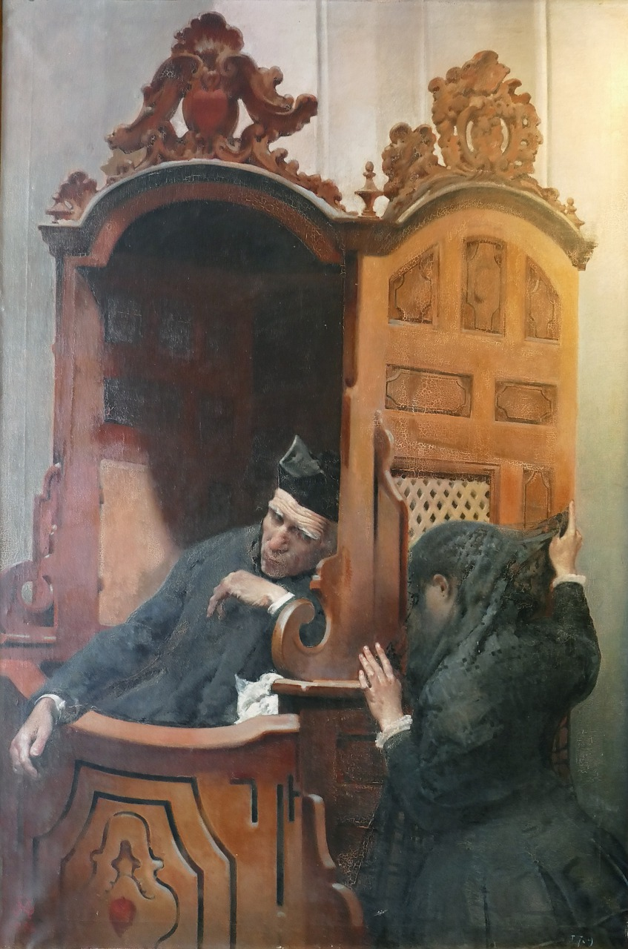

Slide 11
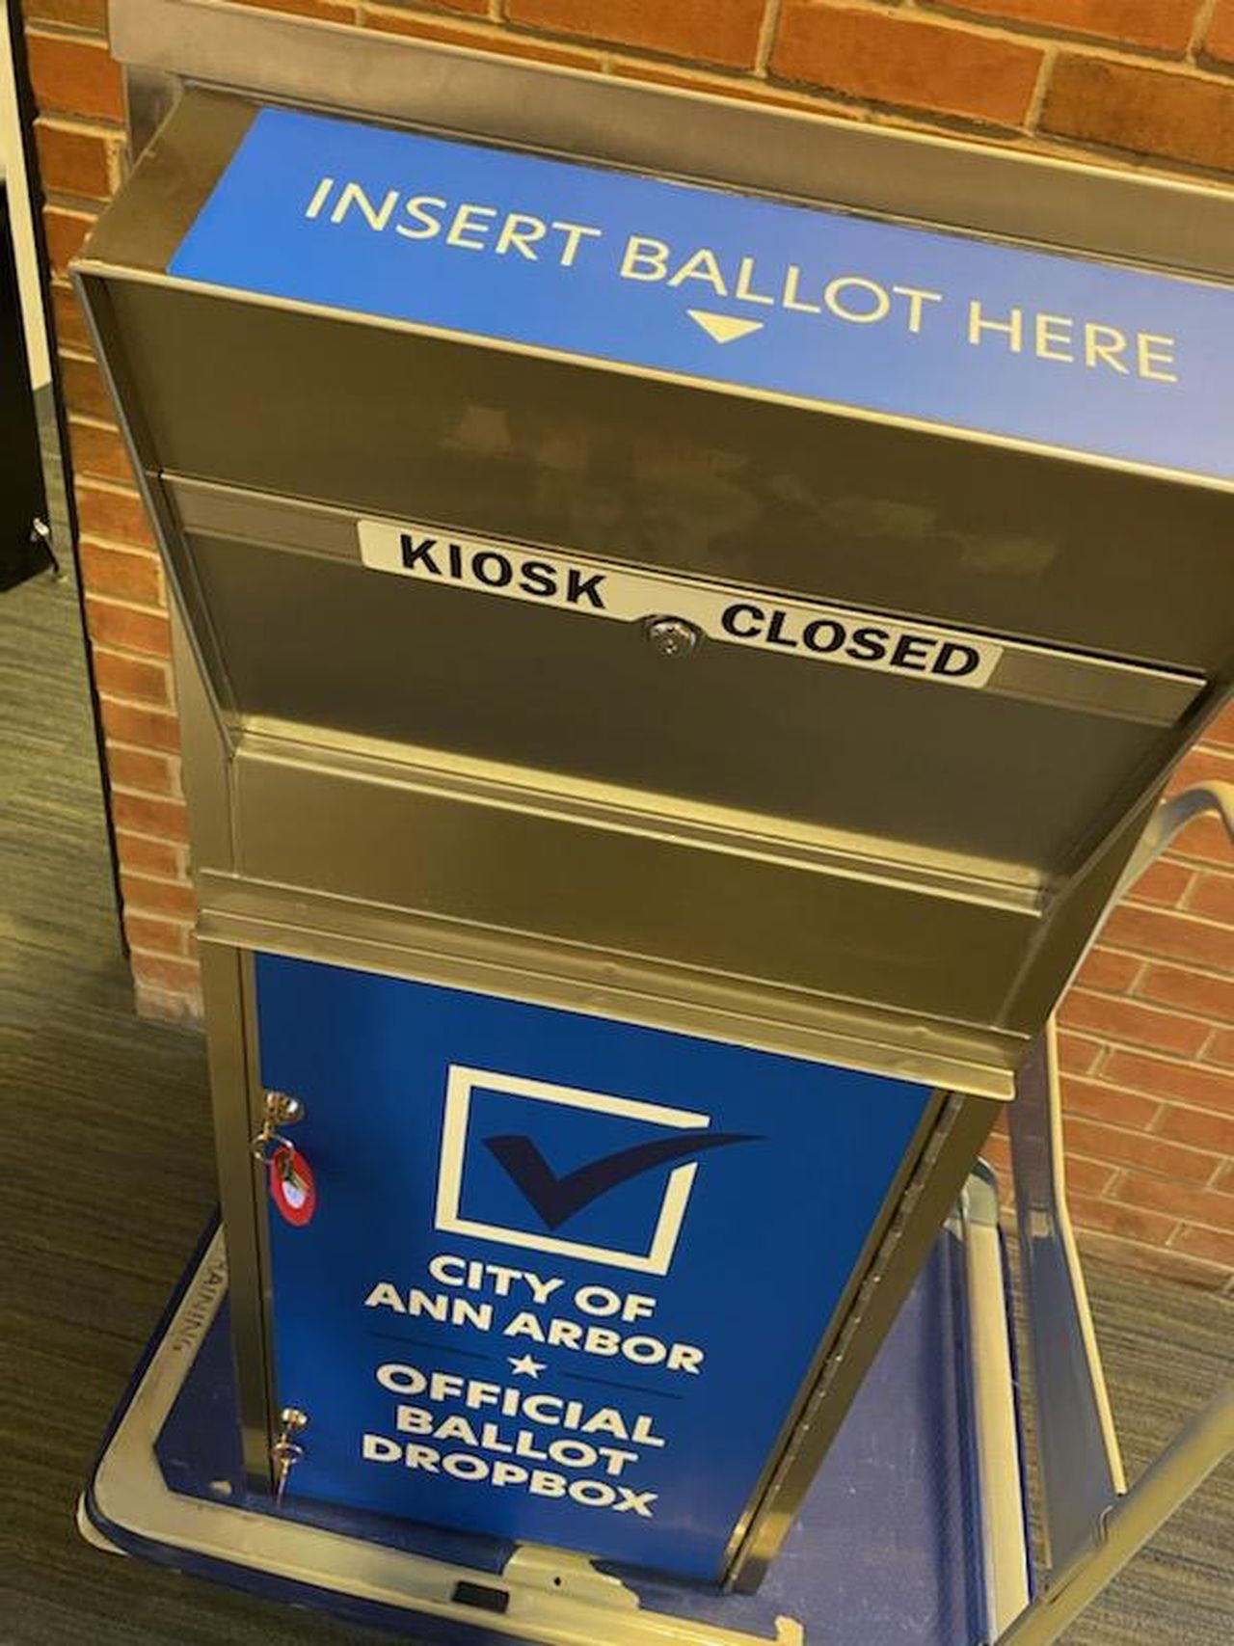

Slide 13
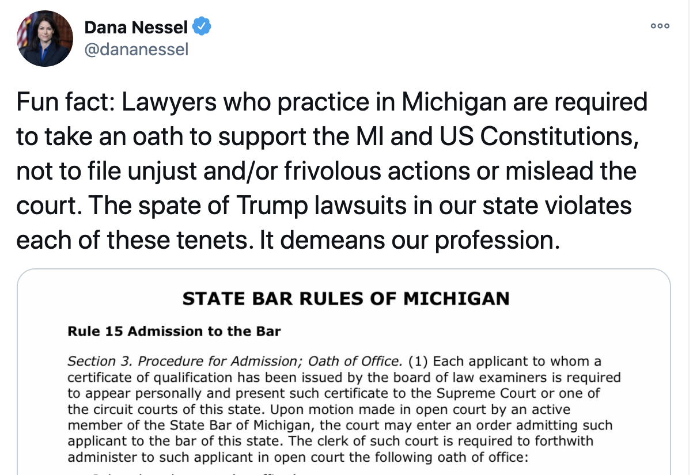

Slide 14
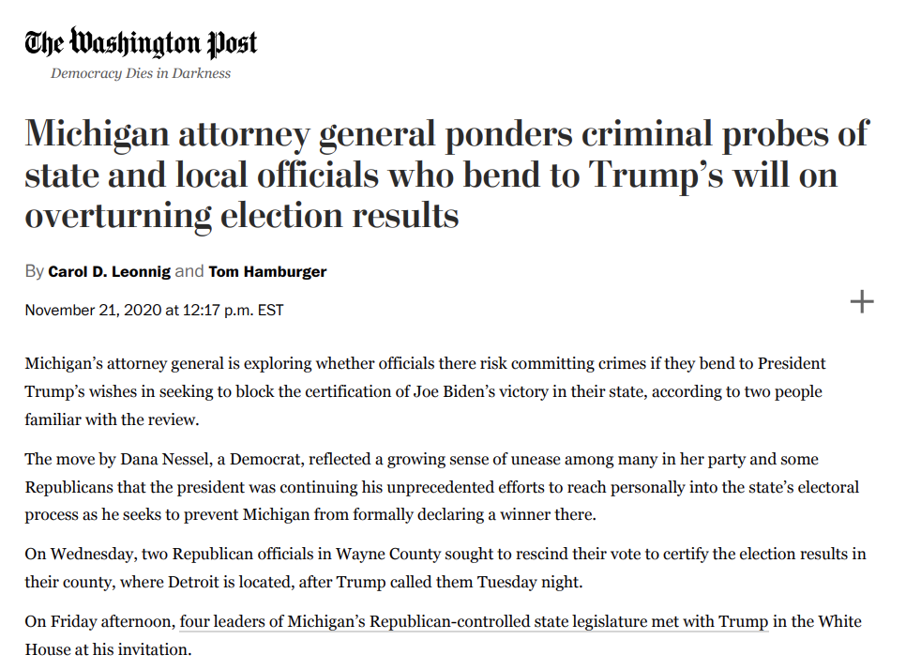

Slide 15
Closed-door meeting for electors sparks controversy, safety concerns
December 12, 2020
Democrats and electors said the meeting is being done without people in the gallery of the state Senate chamber and the building closed due to security reasons given the political climate and COVID-19 restrictions.

Slide 16
Michigan Gov. Whitmer Addresses Security Threat To Electoral College Vote
December 14, 2020
On Monday morning, as electors began to convene in their respective states around the country to vote for president, Michigan Gov. Gretchen Whitmer told NPR's Morning Edition that her state's electors would cast their votes within a closed capitol building, citing a "security issue."
"We know that today's an important day," Whitmer said. "We've always been mindful that it's going to be necessary to make sure everyone is safe."

Slide 17
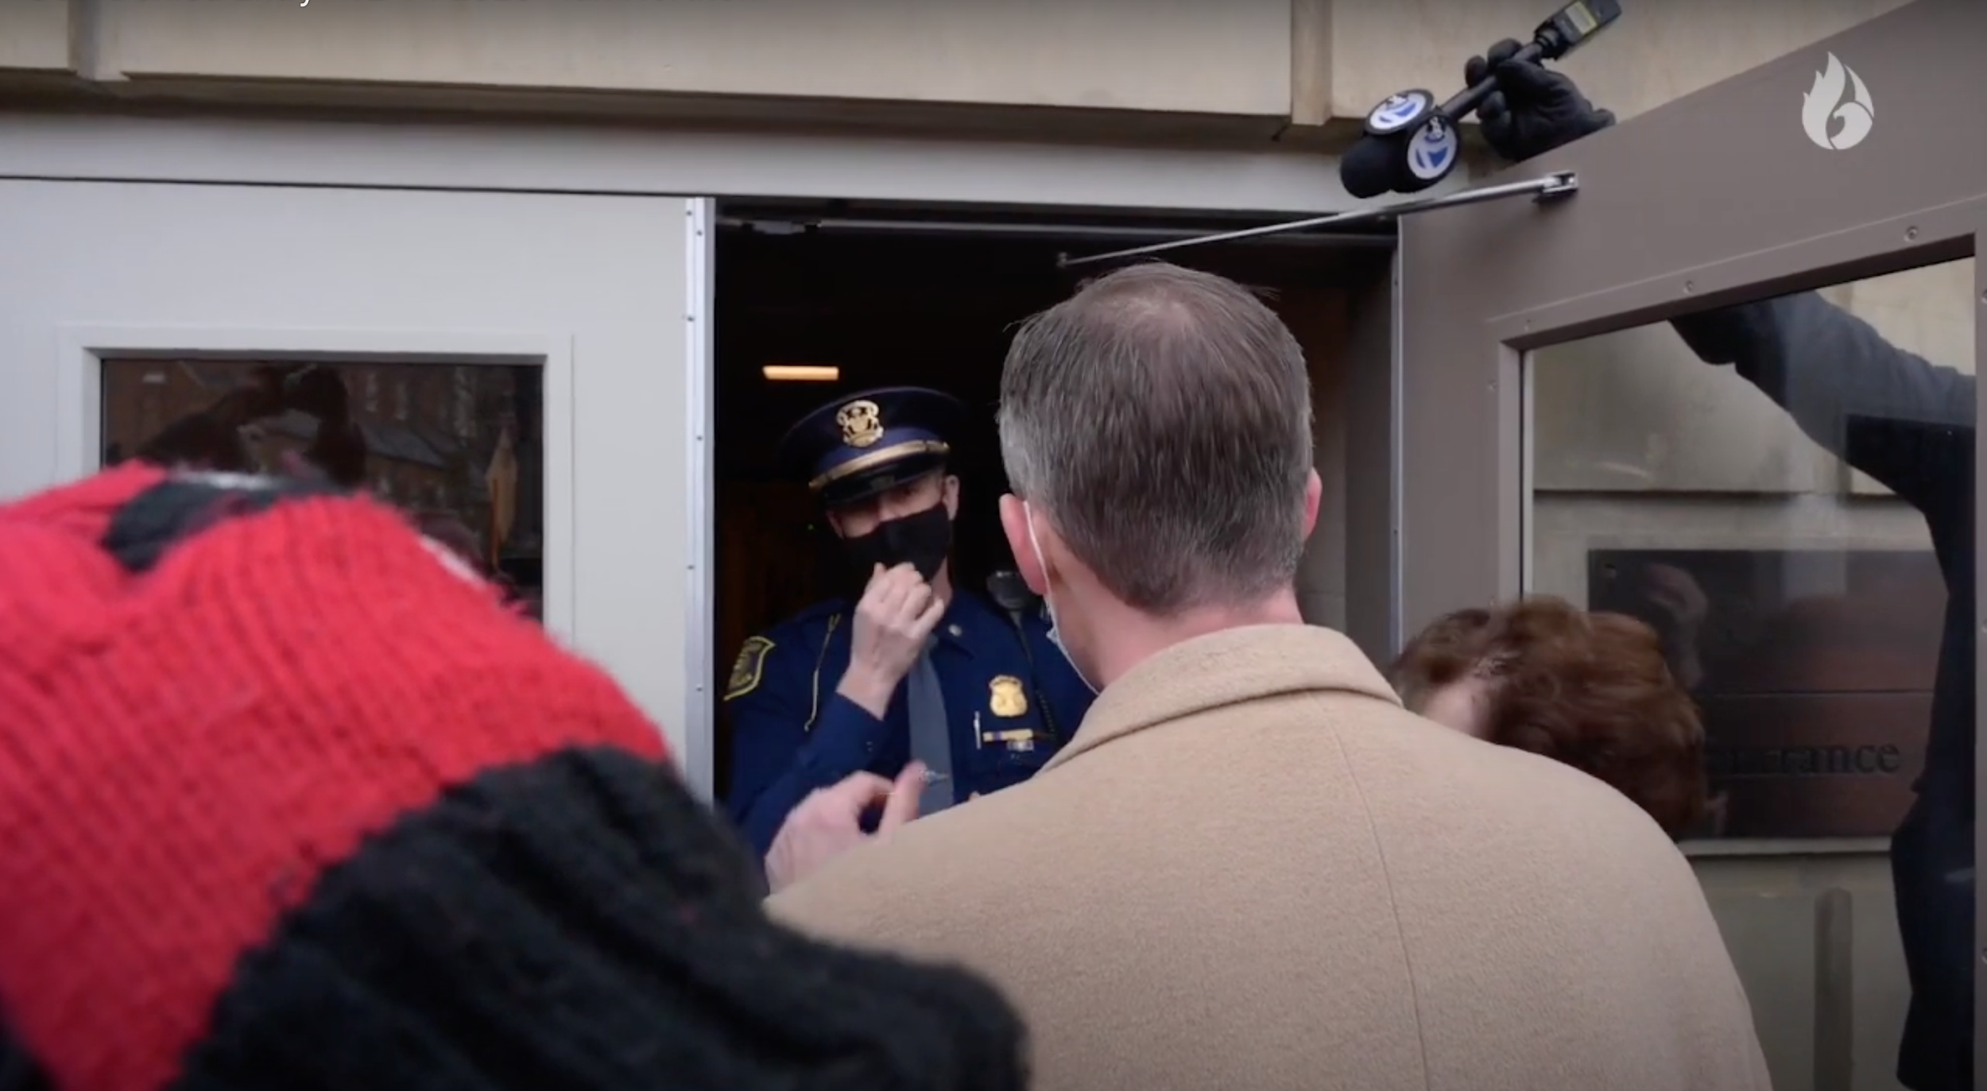

Slide 18
State Police say they were not aware of any credible threats to the capitol on Monday
December 13, 2020
LANSING, Mich. - UPDATE: Mid-Michigan NOW reporter Rachel Louise Just has learned that the Michigan State Police did not recommend the closure of legislative offices ahead of the Electoral College meeting and they were not aware of “any credible threats of violence related to Michigan,” a contrast to what we’ve heard from lawmakers.

Slide 19
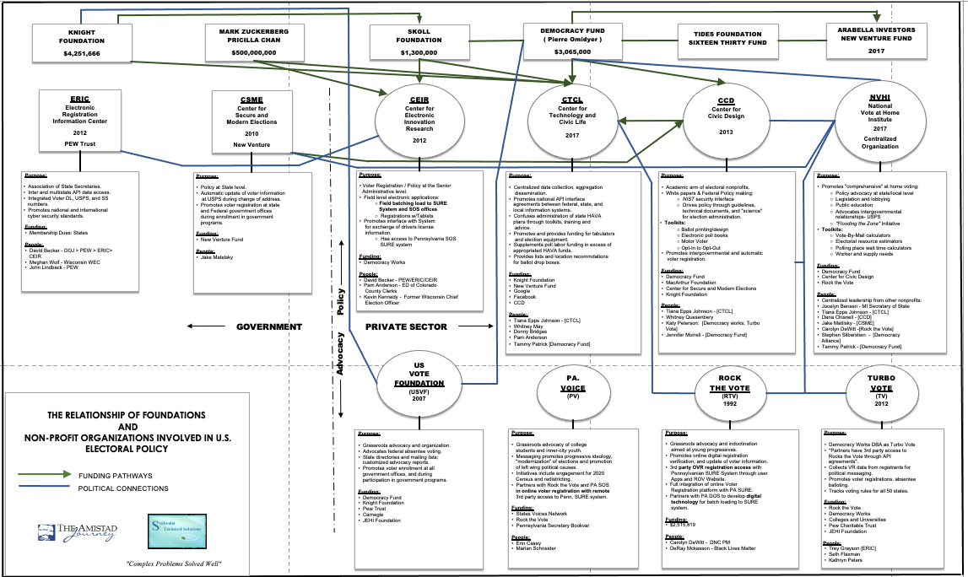

Slide 20
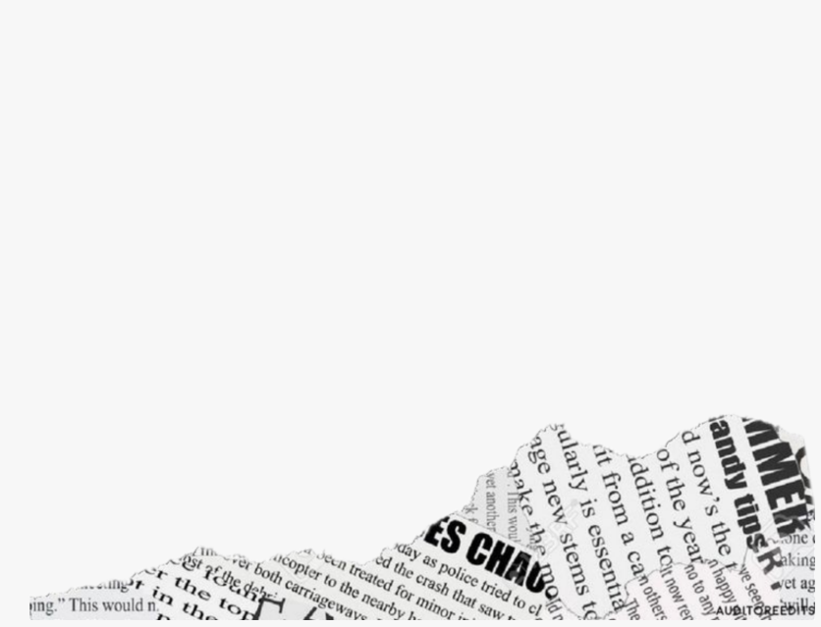
ERIC
Electronic Registration Information Center 2012 PEW Trust
Purpose:
Association of State Secretaries
Inter and multistate API data access
Integrated Voter DL, USPS, and SS numbers
Promotes national and international cyber security standards.
Funding:
Membership Dues: States
People:
David Becker - DOJ > PEW > ERIC> CEIR
Meghan Wolf - Wisconsin

Slide 21
CSME
Purpose:
Policy at State level
Automatic update of voter information at USPS during change of address.
Promotes voter registration at state and Federal government offices during enrollment in government programs.
Funding:
New Venture Fund
People:
Jake Matelsky
Center for Secure and Modern Elections 2010 New Venture

Slide 22
CEIR
Purpose:
Voter Registration / Policy at the Senior Administrative level
Field level electronic applications: ○ Field batching load to SURE System and SOS offices ○ Registrations w/Tablets
Promotes interface with System for exchange of drivers license information. ○ Has access to Pennsylvania SOS SURE system
Funding:
Democracy Works
People:
David Becker - PEW/ERIC/CEIR
Pam Anderson - ED of Colorado County Clerks
Kevin Kennedy - Former Wisconsin Chief Election Officer
Center for Electronic Innovation Research 2012

Slide 23
Purpose:
Centralized data collection, aggregation dissemination.
Promotes national API interface agreements between federal, state, and local information systems.
Confuses administration of state HAVA plans through toolkits, training and advice.
Promotes and provides funding for tabulators and election equipment.
Supplements poll labor funding in excess of appropriated HAVA funds.
Provides lists and location recommendations for ballot drop boxes.
Funding:
Knight Foundation • New Venture Fund • Google • Facebook • CCD
People:
Tiana Epps Johnson - [CTCL] • Whitney May • Donny Bridges • Pam Anderson • Tammy Patrick [Democracy Fund]
CTCL
Center for Technology and Civic Life 2017

Slide 24
CCD
Center for Civic Design 2013
Purpose:
Academic arm of electoral nonprofits
White papers & Federal Policy making: ○ NIST security interface ○ Drives policy through guidelines, technical documents, and "science" for election administration
Toolkits: ○ Ballot printing/design ○ Electronic poll books ○ Motor Voter ○ Opt-In to Opt-Out
Promotes intergovernmental and automatic voter registration.
Funding:
Democracy Fund
MacArthur Foundation
Center for Secure and Modern Elections
Knight Foundation
People:
Tiana Epps Johnson - [CTCL]
Whitney Quesenbery
Katy Peterson: [Democracy works; Turbo Vote]
Jennifer Morrell [Democracy Fund]

Slide 25
NVHI
National Vote at Home Institute 2017 Centralized Organization
Purpose:
Promotes "comprehensive" at home voting: ○ Policy advocacy at state/local level ○ Legislation and lobbying ○Public education ○ Advocates Intergovernmental relationships- USPS ○ "Flooding the Zone" Initiative
Toolkits: ○ Vote-By-Mail calculators ○ Electoral resource estimators ○ Polling place wait time calculators ○ Worker and supply needs
Funding:
Democracy Fund
Center for Civic Design
Rock the Vote
People:
Centralized leadership from other nonprofits:
Jocelyn Bensen - MI Secretary of State
Tiana Epps Johnson - [CTCL]
Dana Chisnell - [CCD]
Jake Matilsky - [CSME]
Carolyn DeWitt -[Rock the Vote]
Stephen Silberstien - [Democracy Alliance]
Tammy Patrick - [Democracy Fund]

Slide 26
Purpose:
Grassroots advocacy and organization
Advocates federal absentee voting
State directories and mailing lists; customized advocacy reports
Promotes voter enrollment at all government offices, and during participation in government programs.
Funding:
Democracy Fun
Knight Foundation
Pew Trust
USVF
US Vote Foundation
Carnegie
JEHI Foundation

Slide 27
Purpose:
Grassroots advocacy of college students and inner-city youth
Messaging promotes progressive ideology, "modernization" of elections and promotion of left-wing political causes
Initiatives include engagement for 2020 Census and redistricting
Partners with Rock the Vote and PA SOS in online voter registration with remote 3rd party access to Penn. SURE system
Funding:
States Voices Network
Rock the Vote
PV
PA. Voice
Pennsylvania Secretary Bookvar

Slide 28
Purpose:
Grassroots advocacy and indoctrination aimed at young progressives
Promotes online digital registration verification, and update of voter information
3rd party OVR registration access with Pennsylvanian SURE System through user Apps and ROV Website
Full integration of online Voter Registration platform with PA SURE
Partners with PA DOS to develop digital technology for batch loading to SURE system.
RTV
Rock the Vote
Funding: $2,515,819
People:
Carolyn DeWitt DNC PM
DeRay Mckesson Black Lives Matter

Slide 29
Purpose:
Democracy Works DBA as Turbo Vote
"Partners have 3rd party access to Rocks the Vote through API agreements"
Collects VR data from registrants for political messaging
Promotes voter registrations, absentee balloting
Tracks voting rules for all 50 states.
Funding:
Rock the Vote
Democracy Works
Colleges and Universities
Pew Charitable Trust
JEHI Foundation
TV
Turbo Vote 2012
People:
Trey Grayson [ERIC]
Seth Flaxman
Kathryn Peters

Slide 30
CTCL TOP 21 CHART

Slide 31
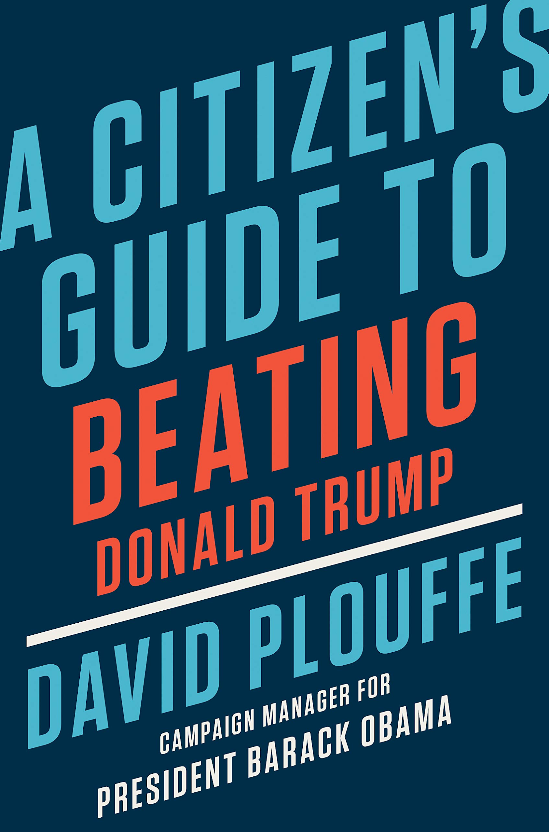

Slide 32
Racine
Mayor Letter
“The City of Racine shall grant ten thousand dollars (USD $10,000) under this agreement to each of the cities of Green Bay, Kenosha, Madison, and Milwaukee solely for the public purpose of planning safe and secure election administration in those cities in 2020, and solely upon written confirmation from those entities that the funds shall be used for such purpose.”

Slide 34
Wisconsin Safe
Voting Plan 2020
Submitted to the Center for Tech & Civic Life
Recommendation I: Encourage and Increase Absentee Voting (By Mail and Early, In-Person) 1. Provide assistance to help voters comply with absentee ballot requests & certification requirements 2. Utilize secure drop-boxes to facilitate return of absentee ballots 3. Deploy additional staff and/or technology improvements to expedite & improve accuracy of absentee ballot processing 4. Expand In-Person Early Voting (Including Curbside Voting)

Slide 35
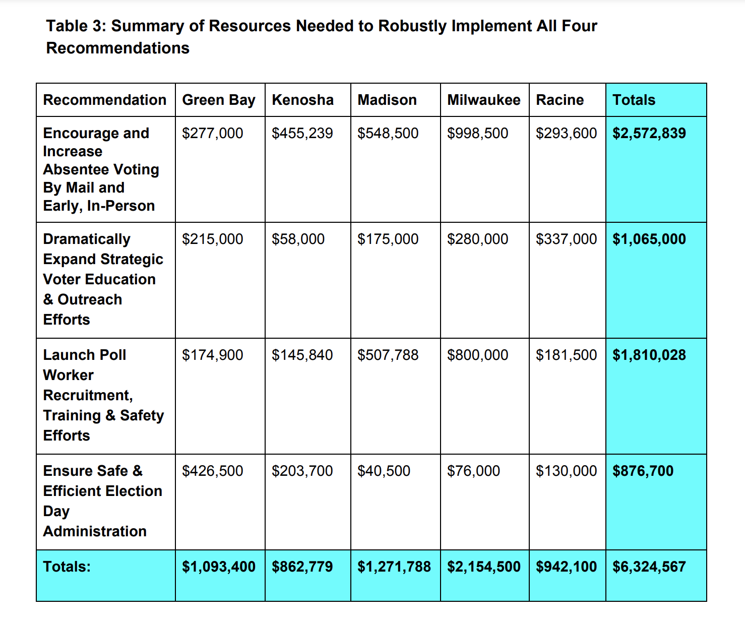
Wisconsin Safe
Voting Plan 2020
Submitted to the Center for Tech & Civic Life

Slide 36
Wisconsin Safe
Voting Plan 2020
Submitted to the Center for Tech & Civic Life
Voting absentee by mail has been complicated by the fairly recent imposition of state law requiring voters to provide an image of their valid photo ID prior to first requesting an absentee ballot.

Slide 37
Philly-CTCL Grant Agreement
PHILLY-CTCL GRANT AGREEMENT
“The City and the Commissioners shall work to secure 800 or more in-person polling places on Election Day”

Slide 38
Philly-CTCL Grant Agreement
PHILLY-CTCL GRANT AGREEMENT
“The City and the Commissioners have submitted to CTCL a plan which includes a section entitled “Secure Dropboxes.” The City shall communicate any changes from this section of the plan including any reduction in the planned number, operating hours, or operating dates of satellite election centers and shall communicate the reasons for any such reduction.”

Slide 39
CTCL’S MATH
DOES NOT
ADD UP
There is one dropbox and./or satellite office for every 20,529 voters in the 8 PA counites carried by Hillary Clinton. There is one dropbox/satellite office for every 72,588 voters in the 59 counties carried by Trump.
There is a drop box per every 35.59 square miles for voters in Clinton counties. That is one drop box for every 6 mile by 6 mile square, or a drop box within 3 miles of every home. There is a dropbox for every 1,046 square miles per voter in Trump counites. That is one drop box for every 33 mile by 33 mile square or a drop box within 17 miles of every home.
100% of the counites Clinton carried received dropboxes/satellite offices and Zuckerberg monies.
22% of the Trump counties (13 of 59) received dropboxes and Zuckerberg monies.
These facts expose the misleading nature of CTCL’s announcement that they have given to more Trump counties than Clinton counties.

Slide 40
Philly-CTCL Grant Agreement
PHILLY-CTCL GRANT AGREEMENT
“CTCL may discontinue, withhold part of, or request the return of all or part of any unspent Grant funds if it determines, that any of the above conditions have not been met.”

Slide 41
Philly-CTCL Grant Agreement
PHILLY-CTCL GRANT AGREEMENT
“For each division to have a full, 5-member Election Board (Judge of Elections, two Inspectors of Election, one Clerk, and one Machine Inspector) will require recruiting, training, and assigning up to 8,515 poll workers (1,703 divisions x 5 Election Board members). Philadelphia's Election Board unit is reaching out and confirming Election Board workers currently, earlier than usual. Currently the Election Board unit has confirmed 1,898 Election Board Workers.”

Slide 42
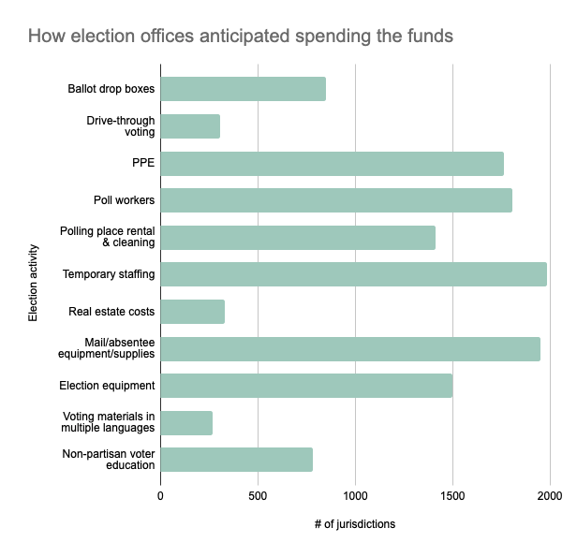

Slide 46
STATUTES VIOLATED BY STATE
ARIZONA, GEORGIA, WISCONSIN, MICHIGAN, PENNSYLVANIA

Slide 47
ARIZONA
State officers and Maricopa County Officials failed to enforce the state law against private companies from directing federal election administration and allowed for gaps in elector ballot chain of custody through the use of “mobile” drop boxes that are stationed in unsupervised public locations.
State officers and Maricopa County Officials failed to enforce the state law against double voting.
State officers and Maricopa County Officials failed to enforce the state law against allowing people to vote using an address where they no longer live.

Slide 48
GEORGIA
Disparate impact of Georgia voters through a private corporation directing federal election administration through grants. For example, Fulton County, flush with cash, initiated public-private coordinated voter registration drives allowing private access directly to government voter registration files, access to early voting opportunities, along with the coordinated provision of incentives for early voters and the off-site collection of ballots, establishes disparate impact. Outside of Fulton County, election officials were unable in initiate equal efforts.
For example, Fulton County, flush with cash initiated public-private coordinated voter registration drives allowing private access directly to government voter registration files, access to early voting opportunities, along with the coordinated provision of incentives for early voters and the off-site collection of ballots, establishes disparate impact. Harding Decl., Exs. A, B, C. Outside of Fulton County, election officials were unable in initiate equal efforts.
In addition, the private corporation money allowed for the distribution of unattended ballot drop boxes in the privately funded counties. The funded counties had a drop box every 14 square miles while unfunded counties had a drop box every 294 square miles.
Violate Georgia absentee laws, such as Ga. Code § 21-2-386, through a settlement agreement between the Secretary of State and Democrat Party Agencies (Democrat Party of Georgia, DSCC, DCCC). This agreement created rules for processing absentee ballots that directly contradict the legislature’s intent.
Georgia’s election officials did not enforce state law residency requirements on voters who changed addresses before the November 3, 2020 election.
Georgia’s election officials did not enforce state law against double voting.

Slide 49
WISCONSIN
Wisconsin cities accepted private sector funding for election administration in return for the non-profit organization directing how elections are administered. In Wisconsin, cities and counties may only take in revenue from taxes, bonding, fines, fees or state grants. Wisconsin Statutes §§ 59.51, 65.07, and, generally, Ch. 70.
Other than taxation revenue, Wisconsin cities are not allowed to accept other monies for election administration other than federal Help America Vote Act grants. This money must come from the Wisconsin Election Commission. Wisconsin Statutes § 5.05 (10) & (11).
Wisconsin cities allowed for gaps in elector ballot chain of custody through the use of “mobile” drop boxes that are stationed in unsupervised public locations where Wisconsin law requires that the absentee elector must either mail the absentee ballot envelope or deliver the absentee ballot envelope to the municipal clerk. Wisconsin Statutes § 6.87 (3)(b)(1).
The Wisconsin Elections Commission issued a directive to county and municipal clerks to not reject indefinitely confined absentee voters even if the clerk possesses reliable information that the allegedly indefinitely confined absentee voter is no longer indefinitely confined. These actions were not a valid exercise of discretion under Wis. Stat. § 6.86 (2)(a-b).
The Wisconsin Election Commission again went beyond its discretion under Wisconsin law when it distributed guidance to county and city clerks that they could use any resources at their disposal to fill in information electors forgot on their absentee ballot certificates. Following this guidance, the Milwaukee Election Commission instructed clerks reviewing absentee envelope certifications to also “cure” or fill in missing information on the envelope. This is another invalid use of discretion under Wis. Stat. § 6.87 (6)(d).

Slide 50
MICHIGAN
Michigan election officials failed to provide meaningful observation is a violation of the Michigan Constitution, Const. 1963, art 2, § 4(1)(h), as well as state statute MCL § 168.765a(12).
Election officials violated the plain language of the law MCL § 168.765a by permitting thousands of ballots to be filled out by hand and duplicated on site without oversight from bipartisan poll challengers.
Election officials again violated MCL § 168.765a by allowing unsecured QVF access to private corporations. Groups like Rock the Vote were allowed to have direct access to state voter files in order to register votes. This also created the opportunity to create new voters in the system.
Numerous statewide irregularities in absentee ballot oversight led to state officials circulating guidance or ignoring laws. For instance, when a ballot is unable to be read by an election device, MCL § 168.765a dictates an observer for each party approves curing a ballot when an election official will determine the will of the voter and transfer it to a new ballot. Many times it was observed that only a Democrat observer approved the changes.
In violation of Michigan law to secure ballots, the City of Detroit held a drive-in ballot drop off where individuals would drive up and drop their ballots into an unsecured tray. No verification was done. This was not a secured drop-box with video surveillance. To encourage this practice, free food and beverages were provided to those who dropped off their ballots using this method.
The acceptance of private money from the Center for Tech and Civic Life is a violation of the Help America Vote Act because Counties and cities cannot spend money on federal elections without going through the proper state and federal channels under HAVA transparency rules.

Slide 51
PENNSYLVANIA
Mark Zuckerberg, through his donations to the Center for Tech and Civic Life, is attempting to administer Pennsylvania’s Presidential federal election through their conditional grants. Paying for federal elections is synonymous with influencing federal election policy and is a violation of the Elections Clause.
Under the Elections Clause, counties and cities, as political subdivisions of a state, have no power to accept private money to pay for federal elections.
The social contract of the Federal Elections Clause requires exclusively-publicly-funded federal elections, thus prohibiting such private federal election grants. According to Appellants, not even Congress can authorize the private funding of our federal elections without violating the Elections Clause.
The second legal proposition is that the federal common law under the Elections Clause recognizes such private financing as tortious interference with the social contract embedded in the Elections Clause and recognizes citizens as a third party beneficiary of that social contract for lawsuit purposes.
The third legal proposition is that the federal common law under the Elections Clause recognizes Article III standing, including an actual and concrete injury, for a citizen within a political subdivision to challenge the political subdivision accepting private federal election grants interfering with the citizen’s Elections Clause guarantee of exclusively publicly-funded federal elections.

